Slide 1

Software Project Management
4th Edition
Chapter 1
An Introduction
Robert Hughes and Mike Cotterell

Slide 2
Outline of talk
In this introduction the main questions to be addressed will be:
  What is software project management? Is it really different from ‘ordinary’ project management?
  How do you know when a project has been successful? For example, do the expectations of the customer/client match those of the developers?
Notes:
The two key questions are:
What exactly is software project management?
This is going to be tackled by looking firstly at what is meant by ‘project’. We are then going to examine whether ‘software project management’ is really different from ‘normal’ project management. Is there anything special about software as opposed to other engineered artefacts?
2. How do we define whether a project is a success or not?
The point about studying project management is to be able to have successful projects. So how do we know if we have been successful?

Slide 3
What is a project?
Some dictionary definitions:
“A specific plan or design”
“A planned undertaking”
“A large undertaking e.g. a public works scheme”
Longmans dictionary
Key points above are planning and size of task
Notes:
Here are some definitions of ‘project’. No doubt there are other ones: for example
‘Unique process, consisting of a set of coordinated and controlled activities with start and finish dates, undertaken to achieve an objective conforming to specific requirements, including constraints of time, cost and resources’
BSO ISO 10006: 1997

Slide 4
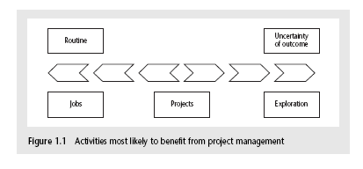
Jobs versus projects
‘Jobs’ – repetition of very well-defined and well understood tasks with very little uncertainty
‘Exploration’ – e.g. finding a cure for cancer: the outcome is very uncertain
‘Projects’ – in the middle!
Notes:
On the one hand there are repetitive jobs a similar task is carried out repeatedly, for example Kwikfit replacing a tyre on a car or a lecturer giving an introductory talk on project management. The task is well-defined and there is very little uncertainty. In some organizations, software development might tend to be like this – in these environments software process management might be more important than software project management
On the other hand some exploratory activities are very uncertain. Some research projects can be like this – we may not be sure what the outcome will be, but we hope that we will learn some things of importance. It may be very difficult to come up with precise plans, although we would probably have some idea of a general approach.
Projects seem to come somewhere between these two extremes. There are usually well-defined hoped-for outcomes but there are risks and uncertainties about achieving those outcomes.

Slide 5
Characteristics of projects
A task is more ‘project-like’ if it is:
Non-routine
Planned
Aiming at a specific target
Work carried out for a customer
Involving several specialisms
Made up of several different phases
Constrained by time and resources
Large and/or complex
Notes:
Exercise 1.1 in the Software Project Management text is a good way of introducing this material if you have time. I have found this exercise to be a good ‘ice-breaker’. Get each student to list the example activities in an order which matches the degree to which they merit the description of ‘project’. You can create a grid on a whiteboard with the projects on the vertical axis and the positions 1st, 2nd, 3rd etc on the horizontal axis. You then go through asking how many put ‘producing a newspaper’ first, second, etc. (Avoid making jokes about this being like the Eurovision song contest). This is time-consuming but it does mean that every student participates in building up a general picture of people’s perceptions, and you can discuss disagreements in perceptions as you go along.

Slide 6
Are software projects really different from other projects?
Not really! …but…
Invisibility
Complexity
Conformity
Flexibility
make software more problematic to build than other engineered artefacts.
Notes:
This is based on Fred Brooks’ paper No Silver Bullet: Essence and Accidents of Software Engineering which appeared in IEEE Computer 20(4) pp10-19 April 1987

Slide 7
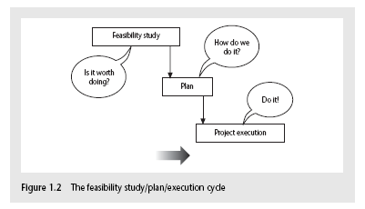
Activities covered by project management
Feasibility study
  Is project technically feasible and worthwhile from a business point of view?
Planning
  Only done if project is feasible
Execution
  Implement plan, but plan may be changed as we go along
Notes:
There are two key points here.
Often you see something like ‘feasibility study’ being put as the first stage of development life cycle, and indeed it might be. However, the outcome of the feasibility study might be not to carry out the proposed project. Planning of the project should therefore take place after the feasibility study (or as a part of the feasibility study perhaps). Clearly the feasibility study itself might need a plan.
All plans are to some extent provisional and subject to change. The key point is that the evolving plan allows us to control the project.

Slide 8
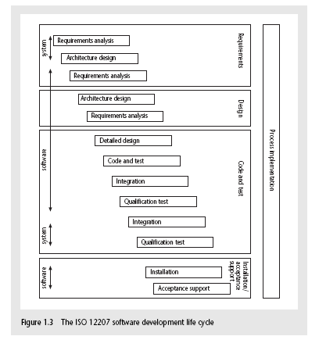
The software development life-cycle (ISO 12207)
Notes:
This section of the lecture discusses the software development life cycle. Note that this is a technical model. It identifies the technical constraints on the order activities are done. This does NOT imply that a ‘waterfall’ approach is the only way to organize projects. The technical model could be implemented as increments or in an evolutionary manner.

Slide 9
ISO 12207 life-cycle
Requirements analysis
  Requirements elicitation: what does the client need?
  Analysis: converting ‘customer-facing’ requirements into equivalents that developers can understand
  Requirements will cover
    Functions
    Quality
    Resource constraints i.e. costs
Notes:
The key point here is that requirement analysis has to face in (at least) two different directions. It needs to communicate and elicit the requirements of the users, speaking in their language. It needs to organize and translate those requirements into a form that developers can understand and relate to.

Slide 10
ISO 12207 life-cycle
Architecture design
  Based on system requirements
  Defines components of system: hardware, software, organizational
  Software requirements will come out of this
Code and test
  Of individual components
Integration
  Putting the components together
Notes:
The software project will almost certainly be part of a larger project which has non-software elements. In a software engineering environment it could be the software will be embedded in hardware product of some kind. Thus there are system requirements for the product as a whole and software requirements for the software element.
In a business information systems environment, the software development could be a relatively minor part of a much larger organizational change project.

Slide 11
ISO12207 continued
Qualification testing
  Testing the system (not just the software)
Installation
  The process of making the system operational
  Includes setting up standing data, setting system parameters, installing on operational hardware platforms, user training etc
Acceptance support
  Including maintenance and enhancement
Notes:
The confusion about what ‘implementation’ really means could be mentioned. Does it mean implementing the design (that is, coding) or implementing the complete system in its user environment? It is best to use ‘installation’ to describe the latter in order to avoid confusion.

Slide 12
Some ways of categorizing projects
Distinguishing different types of project is important as different types of task need different project approaches e.g.
Information systems versus embedded systems
Objective-based versus product-based
Notes:
With objective-based projects, a general objective or problem is defined, and there are several different ways in which that objective could be reached. The project team have freedom to select what appears to be the most appropriate approach.
With product-based projects, the product is already very strictly defined and the development team’s job is to implement the specification with which they have been presented.
Arguably, information systems projects are more likely to be objective-based than is the case with software engineering.
In many cases, an objective-based project could consider a problem and recommend a solution that is then implemented by a product-based project.
Exercise 1.5 in the text is relevant here.

Slide 13
What is management?
This involves the following activities:
Planning – deciding what is to be done
Organizing – making arrangements
Staffing – selecting the right people for the job
Directing – giving instructions
continued…
Notes:
This list is based on one that can be found in Introduction to Software Project Management and Quality Assurance by Darrel Ince, Helen Sharp and Mark Woodman, McGraw-Hill, 1993.

Slide 14
What is management?
(continued)
Monitoring – checking on progress
Controlling – taking action to remedy hold-ups
Innovating – coming up with solutions when problems emerge
Representing – liaising with clients, users, developers and other stakeholders
Notes:
Exercise 1.6 (a day in the life of a project manager) is of relevance here.

Slide 15
Setting objectives
Answering the question ‘What do we have to do to have a success?’
Need for a project authority
  Sets the project scope
  Allocates/approves costs
Could be one person - or a group
  Project Board
  Project Management Board
  Steering committee
Notes:
Different people who are involved in a project (Stakeholders) will have different interests in the project and are likely to see different outcomes as being important.
For example, end-users would want a system that is ‘user-friendly’, that is, easy to learn and to use, and a system that helps rather than hinders them from doing their jobs. Their managers may be more interested in whether the new system would allow them to reduce staffing levels.
It is important therefore that a set of clearly defined objectives are identified and published for the project. Some individual or group needs to be pinpointed who acts as the main client for the project.
See Exercise 1.7 in the text.

Slide 16
Objectives
Informally, the objective of a project can be defined by completing the statement:
The project will be regarded as a success if………………………………..
Rather like post-conditions for the project
Focus on what will be put in place, rather than how activities will be carried out
Notes:
The focus here needs to be on what the situation will be when the project is completed. In what ways will the world be different? The objectives should avoid describing activities:
e.g. ‘a new payroll application will be operational by 4th April’ not ‘design and code a new payroll application’

Slide 17
Objectives should be SMART
S – specific, that is, concrete and well-defined
M – measurable, that is, satisfaction of the objective can be objectively judged
A – achievable, that is, it is within the power of the individual or group concerned to meet the target
R – relevant, the objective must relevant to the true purpose of the project
T – time constrained: there is defined point in time by which the objective should be achieved
Notes:
I have seen some places where the R is said to stand for ‘resource-constrained’, that is that there is a target cost associated with the achievement of the objective.

Slide 18
Goals/sub-objectives
These are steps along the way to achieving the objective. Informally, these can be defined by completing the sentence…
Objective X will be achieved
IF the following goals are all achieved
A……………
B……………
C…………… etc
Notes:
Scoring a goal in football is a ‘goal’ or sub-objective on the way to achieving the overall objective of winning the match. Sub-objectives and objectives can be nested in a hierarchy, so that the objective of winning the match could itself be a goal or sub-objective on the way to winning the league etc.

Slide 19
Goals/sub-objectives continued
Often a goal can be allocated to an individual.
Individual may have the capability of achieving goal, but not the objective on their own e.g.
Objective – user satisfaction with software product
Analyst goal – accurate requirements
Developer goal – software that is reliable
Notes:
Goals can be formulated in such a way that they represent what an individual or group need to do to contribute to the success of the project’s objectives.
In the example above, the analyst or developer, by themselves, cannot guarantee user satisfaction. However, the analyst can contribute to the achievement of the objective by making sure the users’ requirements are accurately recorded and the developer by making sure that the software is reliable.
See Exercise 1.7 in the text.

Slide 20
Measures of effectiveness
How do we know that the goal or objective has been achieved?
By a practical test, that can be objectively assessed.
e.g. for user satisfaction with software product:
Repeat business – they buy further products from us
Number of complaints – if low etc etc
Notes:
See Exercise 1.8 in the text.

Slide 21
Stakeholders
These are people who have a stake or interest in the project
In general, they could be users/clients or developers/implementers
They could be:
Within the project team
Outside the project team, but within the same organization
Outside both the project team and the organization
Notes:
Each stakeholder will have their own goals and concerns in relation to the project which may be different from those of the project as a whole. For example, a software developer might work to make a living, pay the mortgage, learn new things, solve interesting problems. The main stakeholders need, however, to understand and accept the overall project objectives.

Slide 22
The business case
Benefits of delivered project must outweigh costs
Costs include:
  Development
  Operation
Benefits
  - Quantifiable
  - Non-quantifiable
Benefits
£
Costs
£
Notes:
It is not always possible to put a precise financial on the benefits of a project. The client’s willingness to pay up to a certain price to get a project implemented implies that they have informally identified a value to them of getting that project implemented.

Slide 23
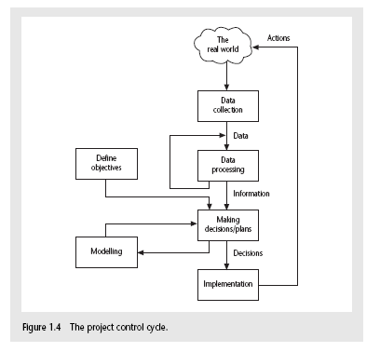
Management control
Notes:
This is explained on the next overhead.

Slide 24
Management control
Data – the raw details
  e.g. ‘6,000 documents processed at location X’
Information – the data is processed to produce something that is meaningful and useful
  e.g. ‘productivity is 100 documents a day’
Comparison with objectives/goals
  e.g. we will not meet target of processing all documents by 31st March
  continued…..
Notes:
This example is expanded in the text.

Slide 25
Management control - continued
Modelling – working out the probable outcomes of various decisions
  e.g. if we employ two more staff at location X how quickly can we get the documents processed?
Implementation – carrying out the remedial actions that have been decided upon
Notes:
The authors’ view is that an initially defective plan can often be remedied by good project control and management. This could be a discussion point.

Slide 26
Key points in lecture
Projects are non-routine - thus uncertain
The particular problems of projects e.g. lack of visibility
Clear objectives are essential which can be objectively assessed
Stuff happens. Not usually possible to keep precisely plan – need for control
Communicate, communicate, communicate!

Slide 27
Software Project Management
4th Edition
Chapter 2
Step Wise: An
approach to planning software projects
Notes:
This talk provides an overview of the basic steps needed to produce a project plan. The framework provided should allow students to identify where some of the particular issues discussed in other chapters are applied to the planning process. As the focus is on project planning, techniques to do with project control are not explicitly described. However, in practice, one element of project planning will be to decide what project control procedures need to be in place.

Slide 28
‘Step Wise’ - aspirations
Practicality
  tries to answer the question ‘what do I do now?’
Scalability
  useful for small project as well as large
Range of application
Accepted techniques
  e.g. borrowed from PRINCE etc
Notes:
The motivation for identifying an overall framework was that students, and others, were often at a loss as to where to start when new to project planning. A structured approach was seen as catering for the needs of such people.
Students are perhaps most likely to come into contact with some kind of project planning (i) when they are involved in student projects, especially those carried in groups and (ii) if they are members of a project team when they are undertaking a placement year in industry. The first situation is probably quite small-scale compared to the second. The same general principles of planning however relate to both.
The approach described here is designed to be applicable to a range of different types of project. For example, multimedia projects are not explicitly discussed, but one of the authors teaches a course project management for multimedia and the general approach described here seems to work satisfactorily when applied to these type of projects.
It might be asked why a standard approach such as PRINCE2 has not been adopted. In fact there is an outline of the PRINCE2 framework in an Appendix to the textbook. There has been caution about using PRINCE2 more centrally because:
PRINCE2 tend to be used mainly in the UK and many users of the Software Project Management textbook are from elsewhere
The content of this course would be vulnerable to changes to the method imposed by its design authority
PRINCE2 tends to focus more on procedural and bureaucratic matters at the expense of techniques – the few planning techniques that are associated with PRINCE, for example, the development of product flow diagrams, are used in the Step Wise approach as well.

Slide 29
‘Step Wise’ - an overview
0.Select
project
1. Identify
project objectives
2. Identify project
infrastructure
3. Analyse
project
characteristics
Review
4. Identify products
and activities
5. Estimate effort
for activity
Lower
level
detail
For each
activity
6. Identify activity
risks
10. Lower level
planning
7. Allocate
resources
9. Execute plan
8. Review/ publicize
plan
Notes:
This is an overview of the main steps, details of which will be discussed in the following overheads:
0. Select project There must be some process by which the project to be executed was selected. Chapter 3 on project evaluation looks at this in more detail.
1. Identify project objectives It is important that at the outset the main stakeholders are all aware of the precise objectives of the project. This has already been discussed in Chapter 1.
2. Identify project infrastructure This may not be a significant step where you are working on an in-house project in a very familiar environment. However, where the project is being carried out for external clients then you may need to investigate the characteristics of the environment in which the project is to be carried out.
3. Analyse project characteristics Different types of project will need different technical and management approaches. For example, a project to implement control software embedded in industrial equipment will need a different set of methods than a project to implement a business information system. A multimedia application would again need a different set of activities. (This is not to say that there could not be considerable overlaps in the approaches).
4. Identify products and activities With software projects, it is best to start by listing the products, both deliverable and intermediate, to be created. The activities needed to create the products can then be identified
5. Estimate effort for activity.
6. Identify activity risks Having assessed the amount of effort and the elapsed time for a project, the reasons why these might be vary during the actual execution of the project need to be considered. Where there is a very high risk of additional effort/time being needed then actions to reduce this risk may be formulated.
7. Allocate resources With software projects, these resources will mainly be staff, but could be equipment etc.
8. Review/publicize It is no good having a plan if no one knows about it
9. Execute Plan
10. Lower level planning Not all of a project, especially when it is large, can be planned in detail at the outset. Not all the information needed to plan the later stages will be available at the beginning: for example software development cannot be broken down into precise sub-tasks with realistic target times until more is known about what the overall design of the system is known.

Slide 30
A project scenario
Hardware/software engineering company (C++ language of choice)
teams are selected for individual projects - some friction has been found between team members
HR manager suggests psychometric testing to select team
Notes:
In this lecture the example is neither the Amanda nor Brigette project, as one that is smaller is needed in order to convey the main ideas in the lecture.
In this scenario, a hardware/software engineering company has been experiencing problems with friction and bad feeling among team members working on software development projects. The human resources manager has looked into these problems and has suggested that software development staff be given psychometric tests so that people can allocated to projects with co-workers who are likely to be temperamentally compatible – see, for example, the Belbin approach discussed in chapter 11.
It has been decided that this might be best implemented by incorporating the testing into a software application, and Visual Basic has been suggested as the programming language. A local university is to be approached to see if there is a student who might be able to implement this application as a final year project.
It is important that staff be willing to use the tool so usability considerations are seen as important.

Slide 31
Project scenario - continued
Software package to be used to test staff
Visual basic suggested as a vehicle for implementation
usability is important - decision to carry out usability tests

Slide 32
Step 1 establish project scope and objectives
1.1 Identify objectives and measures of effectiveness
  ‘how do we know if we have succeeded?’
1.2 Establish a project authority
  ‘who is the boss?’
1.3 Identify all stakeholders in the project and their interests
  ‘who will be affected/involved in the project?’
Notes:
1.1. Identifying objectives and measures of effectiveness. This was discussed in chapter/lecture 1. To revise this students could be asked to try to produce a succinct statement of the objectives for the student described previously. Key points are that the student project objectives must be such that a student can realistically be responsible for their achievement. For instance, an objective to reduce conflict between project team members would be at too high a level for a software developer: he or she is there to produce software and evaluation of the particular pyschometric test would be outside their capabilities. If the student was a psychology student and the project was regarded as a psychological one, then things might be different.
1.2.Establishment of a project authority In the case of students on placement or carrying final year projects for outside organizations, the problem of identifying who has the final say on the project can occur surprisingly often, particular when different user groups have conflicting requirements. In larger, more formal projects, the project authority might reside in a Project Board or steering committee.
1.3 Identify all stakeholders in the project and their interests. Stakeholders can be anyone who has an interest in the project. They may be users of the final application or might be involved in the development or implementation of the project.

Slide 33
Step 1 continued
1.4 Modify objectives in the light of stakeholder analysis
  ‘do we need to do things to win over stakeholders?’
1.5 Establish methods of communication with all parties
  ‘how do we keep in contact?’
Notes:
1.4 Modify objectives in the light of stakeholder analysis. The key point here is the need to ensure commitment to the project from the important stakeholders. This might need to be done by ensuring that there is some benefit from the project for them. Note this is a similar idea to Barry Boehm’s ‘Theory W’ (‘W’ stands for ‘everyone a winner’)
1.5 Establish methods of communication with all parties In the case of a small student project, it might be mainly swapping email addresses and mobile phone numbers. With larger projects, it could involve setting up groups who meet regularly to co-ordinate action. Sometimes specific ‘communication plans’ are drawn up to deal with these issues.

Slide 34
Back to the scenario
Project authority
  should be a project manager rather than HR manager?
Stakeholders
  project team members to complete on-line questionnaires: concern about results?
Revision to objectives
  provide feedback to team members on results
Notes:
Applying these ideas to the scenario introduced earlier:
Project authority Who should the student report to? A software project manager who may know a lot about software development (though not VB) but very little about the subject of the project or the HR manager who might know a lot about psychometric testing but next to nothing about software development.
Stakeholders/revision to objectives The application will not ultimately be a success if project team members are not happy to use the system. They might be happier to use the testing system if the results of their own tests were automatically notified to them personally by the software application, so that this might have to be added as a requirement for the project.

Slide 35
Step 2 Establish project infrastructure
2.1 Establish link between project and any strategic plan
  ‘why did they want the project?’
2.2 Identify installation standards and procedures
  ‘what standards do we have to follow?’
2.3. Identify project team organization
  ‘where do I fit in?’
Notes:
At the same time as establishing exactly what the project objectives are, the person responsible may know little about the organizational environment in which the application is to be developed and implemented. The actions in Step 2 address this problem.

Slide 36
Step 3 Analysis of project characteristics
3.1 Distinguish the project as either objective or product-based.
3.2 Analyse other project characteristics (including quality based ones)
  what is different about this project?
Notes:
Step 3 is about examining the nature of the application to be built and the environment in which it is to be built and implemented and identifying the most appropriate technical approach.
3.1 Objective-based versus product-based projects. With a product-based project the developers have to create a product, the specification of which is often (but not always) clearly defined. In an objective-based project, a problem is defined that needs to be solved but there could be more than one solution. For example, in the case of the psychometric testing project, it could be assumed that the student is simply to develop the software application that will be defined by the company. On the other hand, it might be possible to implement pyschometric testing using purely paper-based questionnaires, or by buying in an existing tool if a broader, objective-based, approach was adopted.
3.2 Analyse other project characteristics – such as is it an information system or an embedded real time or a multimedia application? Is it safety-critical? Etc etc

Slide 37
Step 3 continued
Identify high level project risks
  ‘what could go wrong?’
  ‘what can we do to stop it?’
Take into account user requirements concerning implementation
Select general life cycle approach
  waterfall? Increments? Prototypes?
Review overall resource estimates
  ‘does all this increase the cost?’
Notes:
Identifying high level risks could influence the general approach to the project. For example, if the users appeared to be uncertain about the precise nature of the requirement then a more iterative approach, including the use of prototypes to refine user needs, might be selected.
If the application is very large and complex then breaking it down into increments might be the way to proceed. Chapter/lecture 4 looks at this in more detail.

Slide 38
Back to the scenario
Objectives vs. products
Some risks
  team members worried about implications and do no co-operate
  project managers unwilling to try out application
  Developer not familiar with features of VB
Answer? - evolutionary prototype?
Notes:
The development of an evolutionary prototypes which is tried out at various stages with the ultimate end-users might help to overcome possible anxieties with the system. If the developer is not familiar with VB then they may design an interface etc, which does not fully exploit the features of VB.

Slide 39
Step 4 Identify project products and activities
4.1 Identify and describe project products - ‘what do we have to produce?’
Usability
testing
A product breakdown structure
(PBS)
Selected
subjects
Testing
arrangements
Test results
Change
requests
Booked
PC
Questionnaire
design
Completed
questionnaire
Analysis
report
Notes:
Here we follow the PRINCE approach of firstly identifying the products to be created. These products could be deliverables that will eventually be handed over to the customer, or intermediate products such as specifications and design documents, that are produced along the way.
The PBS is a way of listing these products.
In the scenario, the need for usability testing was identified, and the example of planning a usability test is used here. In order to do the testing, we need a set of selected subjects, a group of people who have similar characteristics to those who will finally use the system and who have agreed to try out the application. We need to have a booked PC that is available for testing when we need it. We are going to give each subject a questionnaire to complete when they have tried out the application (completed questionnaire), but we will need to have a questionnaire design first. We are also to observe the subjects using the application and collect details of things like the time taken to complete standard tasks and the errors they make (test results). These will then be analysed and the results put in an analysis report which will then be used to suggest changes to the application (change requests).
All the boxes in the diagram which are not sub-divided at a lower level represent products. Boxes that are sub-divided (i.e. usability testing and testing arrangements) are names given to the group of activities that are connected to them lower in the hierarchy.

Slide 40
Products
The result of an activity
Could be (among other things)
  physical thing (‘installed pc’),
  a document (‘logical data structure’)
  a person (‘trained user’)
  a new version of an old product (‘updated software’)

Slide 41
Products
The following are NOT normally products:
  activities (e.g. ‘training’)
  events (e.g. ‘interviews completed’)
  resources and actors (e.g. ‘software developer’) - may be exceptions to this
Products CAN BE deliverable or intermediate

Slide 42
Product description (PD)
Product identity
Description - what is it?
Derivation - what is it based on?
Composition - what does it contain?
Format
Relevant standards
Quality criteria
Create a PD for ‘test data’
Notes:
The names of products on the PBS can be rather vague. If you were to ask someone to produce, for example, the ‘analysis report’ in the usability testing scenario, then you would need to explain exactly what you mean by that. This is done via a Product Description. PDs can usually be re-used from one project to another.
Note that they are different from specifications – the explain in general terms what a product is and the description is relevant to all instances of that product. A specification describes a particular instance within the class of products.

Slide 43
Step 4 continued
Testing plan
4.2 document
Generic
product
flows
Selected
subjects
Questionnaire
design
Booked
machine
Completed
questionnaire
Test results
Analysis report
Change
requests
Notes:
The product flow diagram shows the order in which the products have to be completed. Effectively it defines a method of working. Note that as we drew up the PFD for the usability testing scenario, we identified an additional product called ‘testing plan’.
The flow of the PFD is generally from top to bottom and left to right. We do no put in lines which loop back. This is not because iterative and back-tracking is not accepted. Rather it is that you can in theory jump back to any preceding product. For example, when producing the analysis report we might realise that there is a particular type of user that we have not included in our tests. We could go back and find some more selected subjects. However this would potentially mean that all the products that follow the one we have jumped back to would have to be reworked.

Slide 44
Step 4.3 Recognize product instances
The PBS and PFD will probably have identified generic products e.g. ‘software modules’
It might be possible to identify specific instances e.g. ‘module A’, ‘module B’ …
But in many cases this will have to be left to later, more detailed, planning

Slide 45
4.4. Produce ideal activity network
Identify the activities needed to create each product in the PFD
More than one activity might be needed to create a single product
Hint: Identify activities by verb + noun but avoid ‘produce…’ (too vague)
Draw up activity network

Slide 46
An ‘ideal’ activity
Select
subjects
Plan
testing
Design
questionnaire
Conduct
tests
Analyse
results
Draft change
requests
Book
machine
Notes:
The activity network is the basis of the data that is input to planning software tools like MS Project.

Slide 47
Step 4.5 Add check-points if needed
Design
module A
Code
module A
Design
system
Design
module B
Code
module B
Test
system
Design
module C
Code
module C
put in a
check point
Design
module A
Code
module A
Design
system
Design
module B
Check-point
Code
module B
Test
system
Design
module C
Code
module C
Notes:
There are some points in the project when we want to check that the quality of what we have done so far is a sound basis for further work. In the example we have decided to check that all the module designs are compatible with one another before continuing. Note that the benefit of reducing wasted work at a later stage when incompatibilities lead to products being reworked, has to be balanced against the delay caused by the check-point. The start of coding of modules A, B and C all have to wait for the completion of the design of all the modules A, B and C. With no check-point, module A could be coded as soon as the design of module A had been done without having to wait for B and C.

Slide 48
Step 5:Estimate effort for each activity
5.1 Carry out bottom-up estimates
  distinguish carefully between effort and elapsed time
5.2. Revise plan to create controllable activities
  break up very long activities into a series of smaller ones
  bundle up very short activities (create check lists?)
Notes:
Effort is the total number of staff-hours (or days etc) needed to complete a task. Elapsed time is the calendar time between the time task starts and when it ends. If 2 people work on the same task for 5 days without any interruption, then the effort is 10 staff-days and the elapsed time is 5 days.
Using the PBS/PFD to generate the activities often means that some activities are very small and others are huge. Often there is an activity called ‘write software’ which is 70% of a software development project. These large activities need to be broken down into more manageable small tasks. You should aim for the average length of your activities to be about the time between progress meetings e.g. if you have team progress meeting once a fortnight, try to make the tasks last about 2 weeks.
Lecture/chapter 5 explores estimating in some depth.

Slide 49
Step 6: Identify activity risks
6.1.Identify and quantify risks for activities
  damage if risk occurs (measure in time lost or money)
  likelihood if risk occurring
6.2. Plan risk reduction and contingency measures
  risk reduction: activity to stop risk occurring
  contingency: action if risk does occur
Notes:
Note that we have already considered some high level risks that could affect the project as a whole at Step 3. Estimates of the effort and duration of activities can be quite tricky. When you produce an estimate for an activity it is worth reflecting about the events which could cause the assumptions upon which you have based your estimate to be wrong. Where the risk seems very high, then you might try to introduce new activities specifically designed to reduce the risk, or to formulate a contingency action if the risk should materialize. For example, there is not much you can do to stop people getting the flu at a critical time in the project, but you might be able to have a plan to bring in temporary cover for sickness in the case of time-critical activities.
Lecture/chapter 7 focuses particularly on risk.

Slide 50
6.3 Adjust overall plans and estimates to take account of risks
  e.g. add new activities which reduce risks associated with other activities e.g. training, pilot trials, information gathering

Slide 51
Step 7: Allocate resources
7.1 Identify and allocate resources to activities
7.2 Revise plans and estimates to take into account resource constraints
  e.g. staff not being available until a later date
  non-project activities
Notes:
You now need to allocate resources (in particular, staff) to the activities in the plan. Where there is a resource constraint, that is there are not enough staff (or other resource) of the right type to start all the activities that run in parallel at the planned time, then the start of some activities may need to be delayed until the appropriate resources are available.

Slide 52
Gantt charts
LT = lead tester
TA = testing assistant
Week commencing
MARCH
APRIL
5
12
19
26
2
9
16
Plan testing
LT
Select subjects
TA
Design questionnaire
LT
Book machine
TA
Conduct tests
TA
Analyse results
LT
Draft changes
LT
Notes:
We now have the basic information needed to produce a plan. One way of presenting the plan is by means of a Gantt chart (named after Henry Gantt).

Slide 53
Step 8: Review/publicise plan
8.1 Review quality aspects of project plan
8.2 Document plan and obtain agreement
Step 9 and 10: Execute plan and create lower level plans
Notes:
We have noted already that it is not feasible to produce a detailed plan for all stages of the project right at the beginning of the project planning process and not all the information needed for the detailed planning of the later stages is available at the outset. Initially an outline plan for the whole project would be produced, plus a detailed plan for the first stage.

Slide 54
Software Project Management
4th Edition
Chapter 3
Programme management and project evaluation
Notes:
This talk provides an overview of the basic steps needed to produce a project plan. The framework provided should allow students to identify where some of the particular issues discussed in other chapters are applied to the planning process. As the focus is on project planning, techniques to do with project control are not explicitly described. However, in practice, one element of project planning will be to decide what project control procedures need to be in place.

Slide 55
Main topics to be covered
Programme management
Benefits management
Project evaluation
  Cost benefit analysis
  Cash flow forecasting
Project risk evaluation

Slide 56
Programme management
One definition:
‘a group of projects that are managed in a co-ordinated way to gain benefits that would not be possible were the projects to be managed independently’ Ferns
Notes:
The quotation is from a paper that appeared in the International Journal of Project Management August 1991

Slide 57
Programmes may be
Strategic
Business cycle programmes
Infrastructure programmes
Research and development programmes
Innovative partnerships
Notes:
Strategic
Several projects together implement a single strategy. For example, merging two organizations will involve many different activities e.g. physical re-organization of offices, redesigning the corporate image, merging ICT systems etc. Each of these activities could be project within an overarching programme.
Business cycle programmes
A portfolio of project that are to take place within a certain time frame e.g. the next financial year
Infrastructure programmes
In an organization there may be many different ICT-based applications which share the same hardware/software infrastructure
Research and development programmes
In a very innovative environment where new products are being developed, a range of products could be developed some of which are very speculative and high-risk but potentially very profitable and some will have a lower risk but will return a lower profit. Getting the right balance would be key to the organization’s long term success
Innovative partnerships
e.g. pre-competitive co-operation to develop new technologies that could be exploited by a whole range of companies

Slide 58
Programme managers versus project managers
Programme manager
  Many simultaneous projects
  Personal relationship with skilled resources
  Optimization of resource use
  Projects tend to be seen as similar
Project manager
  One project at a time
  Impersonal relationship with resources
  Minimization of demand for resources
  Projects tend to be seen as unique
Notes:
The programme manager may well have a pool of staff upon which to call. He/she will be concerned with ensuring the best use of staff e.g ensuring that staff have regular work with no periods of enforced idleness between project tasks. The project leader would think in terms of ‘I need a Java programmer for four weeks’ without being concerned which specific person it is (beyond obvious concerns that they are fully capable).

Slide 59
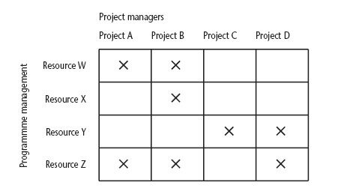
Projects sharing resources
Notes:
During the resource allocation phase of project planning – see chapter/lecture 8 on resource allocation – some project activities could be delayed while waiting for a resource to become available.

Slide 60
Strategic programmes
Based on OGC approach
Initial planning document is the Programme Mandate describing
  The new services/capabilities that the programme should deliver
  How an organization will be improved
  Fit with existing organizational goals
A programme director appointed a champion for the scheme
Notes:
The material here is based on the UK government’s Office of Government Commerce (OGC) approach which is described in detail in their publication Managing successful programmes.
The programme director should be someone who is in a prominent position in the organization so that the seriousness and commitment of the organization to the programme are made clear.
An example of what might be a programme is given in Section 3.4 in the text. It might be found at the IOE company that the customers’ experience of the organization can be very variable and inconsistent. The employee who records the customer’s requirements is different from the people who actually carry out the work and different again from the clerk who deals with accounts. Different maintenance engineers deal with different types of equipment. A business objective might be to present a consistent and uniform interface to the client. This objective might need changes to a number of different systems which until now have been largely self-contained. The work to reorganize each individual area might be treated as separate projects, co-ordinated at a higher level as a programme.

Slide 61
Next stages/documents
The programme brief – equivalent of a feasibility study: emphasis on costs and benefits
The vision statement – explains the new capability that the organization will have
The blueprint – explains the changes to be made to obtain the new capability
Notes:
The programme brief – is it worth it?
The vision statement – the ‘what’
The blueprint – the ‘how’

Slide 62
Benefits management
developers
users
organization
use
for
the
application
benefits
build
to deliver
Providing an organization with a capability does not guarantee that this will provide benefits envisaged – need for benefits management
This has to be outside the project – project will have been completed
Therefore done at programme level

Slide 63
Benefits management
To carry this out, you must:
Define expected benefits
Analyse balance between costs and benefits
Plan how benefits will be achieved
Allocate responsibilities for their achievement
Monitor achievement of benefits
Notes:
Benefit profiles can be produced that document when and how it is planned that the benefits will be experienced.
As different components of the new capability are developed, a series of tranches of projects (projects grouped in different steps of the programme) may be completed, each with a set of associated benefits.
The achievement of benefits might be made the responsibility of staff who are designated as business change managers.

Slide 64
Benefits
These might include:
Mandatory requirement
Improved quality of service
Increased productivity
More motivated workforce
Internal management benefits
Notes:
You could argue that as you have to comply with a mandatory requirement, the question of benefits is irrelevant in this case. However as failure to comply will a negative outcome (e.g. not being able to trade), avoiding that negative outcome is clearly a benefit which could be costed.
‘Internal management benefits’ includes things like better decision-making. In the case of an insurance company a deeper analysis of insurance claims might help identify types of business that are most risky and allow the company to adjust premiums to cover these.

Slide 65
Benefits - continued
Risk reduction
Economies
Revenue enhancement/acceleration
Strategic fit
Notes:
‘Economies’ refers to cost-cutting e.g. using an automated telephone system to direct calls without human intervention could allow an organization to reduce staff.
Revenue enhancement/acceleration e.g. the sooner that bills reach the customers, the sooner they can pay them.
‘Strategic fit’ A change might not benefit any single group within an organization but might have to be made to obtain a benefit for the organization as a whole.

Slide 66
Quantifying benefits
Benefits can be:
Quantified and valued e.g. a reduction of x staff saving £y
Quantified but not valued e.g. a decrease in customer complaints by x%
Identified but not easily quantified – e.g. public approval for a organization in the locality where it is based

Slide 67
Cost benefit analysis (CBA)
You need to:
Identify all the costs which could be:
  Development costs
  Set-up
  Operational costs
Identify the value of benefits
Check benefits are greater than costs
Notes:
Section 3.10 of the text expands this material.
Exercise 3.1 requires students to identify the potential costs and benefits of the Brightmouth College payroll application.

Slide 68
Net profit
Year | Cash-flow
0 | -100,000
1 | 10,000
2 | 10,000
3 | 10,000
4 | 20,000
5 | 100,000
Net profit | 50,000
‘Year 0’ represents all the costs before system is operation
‘Cash-flow’ is value of income less outgoing
Net profit value of all the cash-flows for the lifetime of the application
Notes:
See Section 3.12 for further details. Exercise 3.2 is applicable here

Slide 69
Pay back period
This is the time it takes to start generating a surplus of income over outgoings. What would it be below?
Year | Cash-flow | Accumulated
0 | -100,000 | -100,000
1 | 10,000 | -90,000
2 | 10,000 | -80,000
3 | 10,000 | -70,000
4 | 20,000 | -50,000
5 | 100,000 | 50,000
Notes:
The payback period would be about 4.5 years.
Exercise 3.3. in the text is relevant hee.

Slide 70
Return on investment (ROI)
ROI =
Average annual profit
Total investment
X 100
In the previous example
average annual profit
= 50,000/5
= 10,000
ROI = 10,000/100,000 X 100 = 10%
Notes:
Exercise 3.4. gives further practice is calculating ROI.

Slide 71
Net present value
Would you rather I gave you £100 today or in 12 months time?
If I gave you £100 now you could put it in savings account and get interest on it.
If the interest rate was 10% how much would I have to invest now to get £100 in a year’s time?
This figure is the net present value of £100 in one year’s time
Notes:
If you invested £91 now you would get £9.10 in interest which would give you £100.10 in 12 months

Slide 72
Discount factor
Discount factor = 1/(1+r)^{t}
  r is the interest rate (e.g. 10% is 0.10)
  t is the number of years
In the case of 10% rate and one year
Discount factor = 1/(1+0.10) = 0.9091
In the case of 10% rate and two years
Discount factor = 1/(1.10 x 1.10) =0.8294

Slide 73
Applying discount factors
Year | Cash-flow | Discount factor | Discounted cash flow
0 | -100,000 | 1.0000 | -100,000
1 | 10,000 | 0.9091 | 9,091
2 | 10,000 | 0.8264 | 8,264
3 | 10,000 | 0.7513 | 7,513
4 | 20,000 | 0.6830 | 13,660
5 | 100,000 | 0.6209 | 62,090
 |  | NPV | 618
Notes:
NPV is the sum of the discounted cash flows for all the years of the ‘project’ (note that in NPV terms the lifetime of the completed application is included in the ‘project’)
The figure of £618 means that £618 more would be made than if the money were simply invested at 10%. An NPV of £0 would be the same amount of profit would be generated as investing at 10%.

Slide 74
Internal rate of return
Internal rate of return (IRR) is the discount rate that would produce an NPV of 0 for the project
Can be used to compare different investment opportunities
There is a Microsoft Excel function which can be used to calculate
Notes:
A quite detailed discussion of IRR features in the text in Section 3.12

Slide 75
Dealing with uncertainty: Risk evaluation
project A might appear to give a better return than B but could be riskier
Could draw up draw a project risk matrix for each project to assess risks – see next overhead
For riskier projects could use higher discount rates

Slide 76
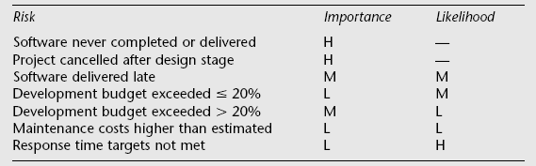
Example of a project risk matrix
Notes:
In the table ‘Importance’ relates to the cost of the damage if the risk were to materialize and ‘likelihood’ to the probability that the risk will actual occur. ‘H’ indicates ‘High’, ‘M’ indicates ‘medium’ and ‘L’ indicates ‘low’. The issues of risk analysis are explored in much more depth in lecture/chapter 7.

Slide 77
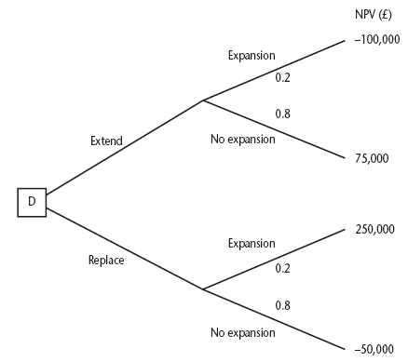
Decision trees
Notes:
The diagram here is figure 3.8 in the text.
This illustrates a scenario relating to the IOE case study. Amanda is responsible for extending the invoicing system. An alternative would be to replace the whole of the system. The decision is influenced by the likelihood of IOE expanding their market. There is a strong rumour that they could benefit from their main competitor going out of business: in this case they could pick up a huge amount of new business, but the invoicing system could not cope. However replacing the system immediately would mean other important projects would have to be delayed.
The NPV of extending the invoicing system is assessed as £75,000 if there is no sudden expansion. If there were a sudden expansion then there would be a loss of £100,000. If the whole system were replaced and there was a large expansion there would be a NPV of £250,000 due to the benefits of being able to handle increased sales. If sales did not increase then the NPV would be -£50,000.
The decision tree shows these possible outcomes and also shows the estimated probability of each outcome.
The value of each outcome is the NPV multiplied by the probability of its occurring. The value of a path that springs from a particular decision is the sum of the values of the possible outcomes from that decision. If it is decided to extend the system the sum of the values of the outcomes is £40,000 (75,000 x 0.8 – 100,000 x 0.2) while for replacement it would be £10,000 (250,000 x 0.2 – 50,000 x 0.80). Extending the system therefore seems to be the best bet (but it is still a bet!).

Slide 78
Remember!
A project may fail not through poor management but because it should never have been started
A project may make a profit, but it may be possible to do something else that makes even more profit
A real problem is that it is often not possible to express benefits in accurate financial terms
Projects with the highest potential returns are often the most risky

Slide 79
Software Project Management
4th Edition
Chapter 4
Selection of an appropriate project approach
Notes:
This talk provides an overview of the basic steps needed to produce a project plan. The framework provided should allow students to identify where some of the particular issues discussed in other chapters are applied to the planning process. As the focus is on project planning, techniques to do with project control are not explicitly described. However, in practice, one element of project planning will be to decide what project control procedures need to be in place.

Slide 80
Selection of project approaches
In-house development: most of these issues resolved by IS planning and standards
Software houses: more applicable as different customers have different needs
Selection of approach governed by:
  uncertainties of the project
  properties of application to be built
Notes:
Sections 4.1 and 4.2 of the textbook discuss these issues. Different types of project need different types of approach. If you are working in one particular environment which specializes in one type of software, then the approach is likely not to change much from one project to another. Where you work for different clients in different organizations developing a variety of applications then the approach for each project may need to be tailored.

Slide 81
General approach
Look at risks and uncertainties e.g.
  are requirement well understood?
  are technologies to be used well understood?
Look at the type of application being built e.g.
  information system? embedded system?
  criticality? differences between target and development environments?
Clients’ own requirements
  need to use a particular method
Notes:
See section 4.2 of the textbook.

Slide 82
Choice of process models
‘waterfall’ also known as ‘one-shot’, ‘once-through’
incremental delivery
evolutionary development
Also use of ‘agile methods’ e.g. extreme programming
Notes:
It could be argued that extreme programming is mainly a particular way of carrying out incremental and evolutionary development

Slide 83
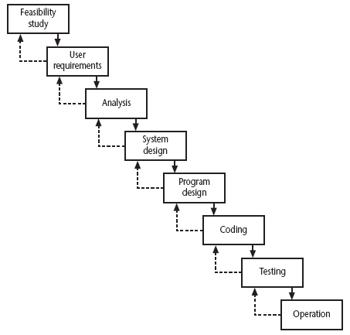
Waterfall
The waterfall model
Notes:
Section 4.6 of the textbook discusses this topic.
We have already touched upon the Waterfall approach in Lecture/Chapter 1 when we discussed the ISO 12207. The way that the Waterfall approach is usually interpreted, it implies that all work on one phase has to be completed and checked off before the next one can start. However, it can be argued that ISO 12207 is really a technical model showing the order technical processes need to be carried out on a software component. You might break down an application into component increments, but the technical processes relating to that increment are carried out in the ISO 12207 sequence. You can, within the ISO 12207 sequence, loop back in an iterative manner, but the technical sequence still remains.

Slide 84
Waterfall
the ‘classical’ model
imposes structure on the project
every stage needs to be checked and signed off
BUT
  limited scope for iteration

Slide 85
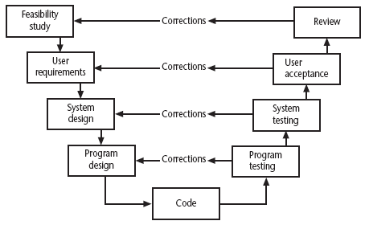
V-process model
Another way of looking at the waterfall model
Notes:
Section 4.7 of the text book discusses this topic
Essentially the testing phase of the Waterfall model is expanded. For each developmental activity going down the slope of the left hand side of the V, there is a matching testing or evaluation phase as you climb up the right hand side of the V.
Each activity checks the implementation of each of the develoomental stages. For example, at the system testing stage systems analyst may be checking that the design that was specified has been correctly implemented. He or she may also be checking the design itself is adequate.

Slide 86
Evolutionary delivery: prototyping
‘ An iterative process of creating quickly and inexpensively live and working models to test out requirements and assumptions’
Sprague and McNurlin main types
‘throw away’ prototypes
evolutionary prototypes
what is being prototyped?
human-computer interface
functionality

Slide 87
Reasons for prototyping
learning by doing
improved communication
improved user involvement
a feedback loop is established
reduces the need for documentation
reduces maintenance costs i.e. changes after the application goes live
prototype can be used for producing expected results
Notes:
A prototype is a working model of one or more aspects of the project application. It is constructed quickly and inexpensively in order to test out assumptions.
Sections 4.9, 4.10 and 4.11 discuss this topic.
learning by doing - useful where requirements are only partially known
improved communication - users are reluctant to read massive documents, but when system is ‘live’ you get a better feeling for it
improved user involvement - user ideas and requests are quickly implemented
the reduction of maintenance costs – the idea is that if you do not have a prototype then the first release of the application will effectively become a prototype as users will find things that they do not like and then ask for them to be changed. It is easier and safer to make such changes before the application becomes operational.
testing - involves devising test cases and then documenting the results expected when the test cases are run. If these are done by hand, then effectively you have a manual prototype. Why not get the software prototype to generate the expected results?

Slide 88
Prototyping: some dangers
users may misunderstand the role of the prototype
lack of project control and standards possible
additional expense of building prototype
focus on user-friendly interface could be at expense of machine efficiency

Slide 89
Other ways of categorizing prototyping
what is being learnt?
  organizational prototype
  hardware/software prototype (‘experimental’)
  application prototype (‘exploratory’)
to what extent
  mock-ups
  simulated interaction
  partial working models: vertical versus horizontal
Notes:
When a prototype is to be produced as part of a student’s final year project, then the learning objectives that the prototypes will help be achieved need to defined at project inception. The details of what has been learnt through the development and exercising of the prototype should be documented during the project.

Slide 90
Incremental delivery
delivered
system
design
build
install
evaluate
increment
1
first incremental delivery
increment
2
design
build
install
evaluate
second incremental delivery
increment
3
design
build
install
evaluate
third incremental delivery
Notes:
The application to be delivered is broken down into a number of components each of which will be actually used by the users. Each of these is then developed as a separate ‘mini-project’ or increment.

Slide 91
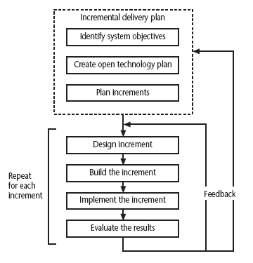
The incremental process
Intentional
incremental
delivery
Notes:
This approach has had a very vocal advocate in Tom Gilb (see the book Principles of Software Engineering Management published by Addison-Wesley (1988)).
Gilb argues that the initial focus should be on high level business objectives. There may be many ways in which important objectives can be achieved and we ought to allow ourselves freedom in the way we try to achieve the objectives.
Open technology plan – we need to ensure that the technologies we use are ones that facilitate the addition of components to an existing application.
Plan increments – the nature and order of the increments to be delivered needs to be delivered to the users have to be planned at the outset.

Slide 92
Incremental approach:benefits
feedback from early stages used in developing latter stages
shorter development thresholds
user gets some benefits earlier
project may be put aside temporarily
reduces ‘gold-plating’:
BUT there are some possible disadvantages
loss of economy of scale
‘software breakage’
Notes:
Advantages of prototyping
feedback from early stages used in developing latter stages
shorter development thresholds - important when requirements are likely to change
user gets some benefits earlier - may assist cash flow
project may be put aside temporarily - more urgent jobs may emerge
reduces ‘gold-plating’ i.e. features requested but not used
But there are possible disadvantages
loss of economy of scale - some costs will be repeated
‘software breakage’ - later increments might change earlier increments

Slide 93
The outline incremental plan
steps ideally 1% to 5% of the total project
non-computer steps should be included
ideal if a step takes one month or less:
  not more than three months
each step should deliver some benefit to the user
some steps will be physically dependent on others

Slide 94
Which step first?
some steps will be pre-requisite because of physical dependencies
others may be in any order
value to cost ratios may be used
  V/C where
  V is a score 1-10 representing value to customer
  C is a score 0-10 representing value to developers

Slide 95
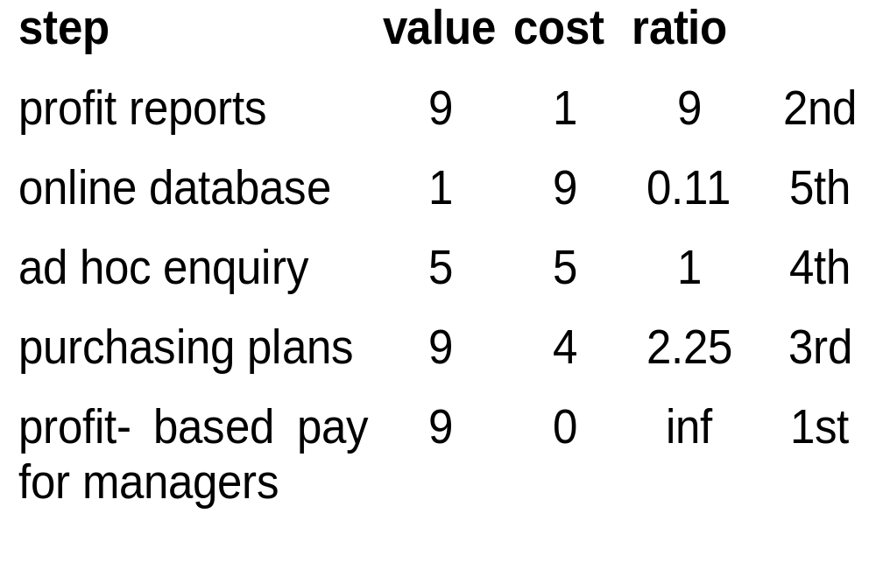
V/C ratios: an example

Slide 96
‘Agile’ methods
structured development methods have some perceived advantages
  produce large amounts of documentation which can be largely unread
  documentation has to be kept up to date
  division into specialist groups and need to follow procedures stifles communication
  users can be excluded from decision process
  long lead times to deliver anything etc. etc
The answer? ‘Agile’ methods?

Slide 97
Dynamic system development method
UK-based consortium
arguably DSDM can be seen as replacement for SSADM
DSDM is more a project management approach than a development approach
Can still use DFDs, LDSs etc!
Notes:
A fuller explanation can be found in Jennifer Stapleton’s DSDM: A Framework for Business-Centred Development Addison-Wesley 2002
SSADM is Structured Systems Analysis and Design Method a very heavy-weight and bureaucratic methodology that was promoted by the UK government
DFD = Data Flow Diagram
LDS = Logical Data Structure, effectively an Entity-Relationship Diagram

Slide 98
Nine core DSDM principles
1. Active user involvement
2. Teams empowered to make decisions
3. Frequent delivery of products
4. Fitness for business purpose
5. Iterative and incremental delivery
6. Changes are reversible
7. Requirements base-lined at a high level
8. Testing integrated with development
9. Collaborative and co-operative approach
Notes:
This can be seen as a re-packaging of a lot of the ideas that have been discussed under the incremental and evolutionary approaches

Slide 99
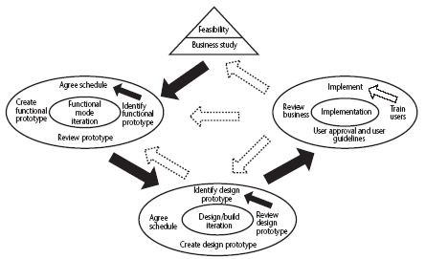
DSDM framework
Figure 4.6 here
DSDM process model
Notes:
The feasibility/business study stage will not only look at the business feasibility of the proposed project, but also as whether DSDM would be the best framework for it. Applications where there is a prominent user interface would be prime candidates.

Slide 100
DSDM: time-boxing
time-box fixed deadline by which something has to be delivered
typically two to six weeks
MOSCOW priorities
  Must have - essential
  Should have - very important, but system could operate without
  Could have
  Want - but probably won’t get!
Notes:
Time-boxes mean that the focus moves from having a fixed set of functional requirements and then extending the planned project completion until they have all been developed. The deadline is fixed and we deliver what we have completed so far even if it is not everything that was originally planned.
In order to make the delivered package coherent and as useful as possible to the users, requirements are prioritized according to the MoSCoW rules.

Slide 101
Extreme programming
increments of one to three weeks
  customer can suggest improvement at any point
argued that distinction between design and building of software are artificial
code to be developed to meet current needs only
frequent re-factoring to keep code structured
Notes:
Associated with Kent Beck - see Extreme programming explained
Developed originally on Chrysler C3 payroll (Smalltalk) project
Agile methods include Jim Highsmith’s Adaptive Software Development and Alistair Cocburn’s Chrystal Lite methods

Slide 102
Extreme programming - contd
developers work in pairs
test cases and expected results devised before software design
after testing of increment, test cases added to a consolidated set of test cases

Slide 103
Grady Booch’s concern
Booch, an OO authority, is concerned that with requirements driven projects:
‘Conceptual integrity sometimes suffers because this is little motivation to deal with scalability, extensibility, portability, or reusability beyond what any vague requirement might imply’
Tendency towards a large number of discrete functions with little common infrastructure?

Slide 104
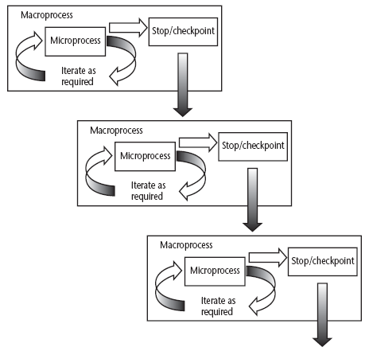
Macro and micro processes
A macro process containing three iterative micro processes
Notes:
Section 4.14 discusses these ideas in a little more detail

Slide 105
‘rules of thumb’ about approach to be used
IF uncertainty is high
  THEN use evolutionary approach
IF complexity is high but uncertainty is not
  THEN use incremental approach
IF uncertainty and complexity both low
  THEN use one-shot
IF schedule is tight
  THEN use evolutionary or incremental

Slide 106
Combinations of approach
installation
one-shot
incremental
evolutionary
one-shot
yes
yes
no
construction
incremental
yes
yes
no
evolutionary
yes
yes
yes
one-shot or incremental installation - any
construction approach possible
evolutionary installation implies evolutionary construction

Slide 107
Software Project Management
4th Edition
Chapter 5
Software effort estimation
Notes:
This talk provides an overview of the basic steps needed to produce a project plan. The framework provided should allow students to identify where some of the particular issues discussed in other chapters are applied to the planning process. As the focus is on project planning, techniques to do with project control are not explicitly described. However, in practice, one element of project planning will be to decide what project control procedures need to be in place.

Slide 108
What makes a successful project?
Delivering:
agreed functionality
on time
at the agreed cost
with the required quality
Stages:
1. set targets
2. Attempt to achieve targets
BUT what if the targets are not achievable?
Notes:
A key point here is that developers may in fact be very competent, but incorrect estimates leading to unachievable targets will lead to extreme customer dissatisfaction.

Slide 109
Over and under-estimating
Parkinson’s Law: ‘Work expands to fill the time available’
An over-estimate is likely to cause project to take longer than it would otherwise
Weinberg’s Zeroth Law of reliability: ‘a software project that does not have to meet a reliability requirement can meet any other requirement’
Notes:
The answer to the problem of over-optimistic estimates might seem to be to pad out all estimates, but this itself can lead to problems. You might miss out to the competition who could underbid you, if you were tendering for work. Generous estimates also tend to lead to reductions in productivity. On the other hand, having aggressive targets in order to increase productivity could lead to poorer product quality.
Ask how many students have heard of Parkinson’s Law – the response could be interesting! It is best to explain that C. Northcote Parkinson was to some extent a humourist, rather than a heavyweight social scientist.
Note that ‘zeroth’ is what comes before first.
This is discussed in Section 5.3 of the text which also covers Brooks’Law.

Slide 110
A taxonomy of estimating methods
Bottom-up - activity based, analytical
Parametric or algorithmic models e.g. function points
Expert opinion - just guessing?
Analogy - case-based, comparative
Parkinson and ‘price to win’
Notes:
This taxonomy is based loosely on Barry Boehm’s in the big blue book, ‘Software Engineering Economics’.
One problem is that different people call these approaches by different names. In the case of bottom-up and analogy some of the alternative nomenclatures have been listed.
‘Parkinson’ is setting a target based on the amount of staff effort you happen to have available at the time. ‘Price to win’ is setting a target that is likely to win business when tendering for work. Boehm is scathing about these as methods of estimating. However, sometimes you might have to start with an estimate of an acceptable cost and then set the scope of the project and the application to be built to be within that cost.
This is discussed in Section 5.5 of the textbook.

Slide 111
Bottom-up versus top-down
Bottom-up
  use when no past project data
  identify all tasks that have to be done – so quite time-consuming
  use when you have no data about similar past projects
Top-down
  produce overall estimate based on project cost drivers
  based on past project data
  divide overall estimate between jobs to be done
Notes:
There is often confusion between the two approaches as the first part of the bottom-up approach is a top-down analysis of the tasks to be done, followed by the bottom-up adding up of effort for all the work to be done. Make sure you students understand this or it will return to haunt you (and them) at examination time.

Slide 112
Bottom-up estimating
1. Break project into smaller and smaller components
[2. Stop when you get to what one person can do in one/two weeks]
3. Estimate costs for the lowest level activities
4. At each higher level calculate estimate by adding estimates for lower levels
Notes:
The idea is that even if you have never done something before you can imagine what you could do in about a week.
Exercise 5.2 relates to bottom-up estimating

Slide 113
Top-down estimates
Estimate
100 days
Produce overall estimate using effort driver (s)
distribute proportions of overall estimate to components
overall
project
design
code
test
30%
i.e.
30 days
30%
i.e.
30 days
40%
i.e. 40 days

Slide 114
Algorithmic/Parametric models
COCOMO (lines of code) and function points examples of these
Problem with COCOMO etc:
guess
algorithm
estimate
but what is desired is
system
characteristic
algorithm
estimate
Notes:
The problems with COCOMO is that the input parameter for system size is an estimate of lines of code. This is going to have to be an estimate at the beginning of the project.
Function points, as will be seen, counts various features of the logical design of an information system and produced an index number which reflects the amount of information processing it will have to carry out. This can be crudely equated to the amount of code it will need.

Slide 115
Parametric models - continued
Examples of system characteristics
  no of screens x 4 hours
  no of reports x 2 days
  no of entity types x 2 days
the quantitative relationship between the input and output products of a process can be used as the basis of a parametric model
Notes:
It would be worth getting the students to do Exercise 5.3 at this point to make sure they grasp the underlying concepts.

Slide 116
Parametric models - the need for historical data
simplistic model for an estimate
estimated effort = (system size) / productivity
e.g.
  system size = lines of code
  productivity = lines of code per day
productivity = (system size) / effort
  based on past projects
Notes:
This is analogous to calculating speed from distance and time.

Slide 117
Parametric models
Some models focus on task or system size e.g. Function Points
FPs originally used to estimate Lines of Code, rather than effort
Number
of file types
  model
‘system
size’
Numbers of input
and output transaction types
Notes:
‘System size’ here can be seen as an index that allows the size of different applications to be compared. It will usually correlate to the number of lines of code required.

Slide 118
Parametric models
Other models focus on productivity: e.g. COCOMO
Lines of code (or FPs etc) an input
Estimated effort
System
size
Productivity
factors
Notes:
COCOMO originally was based on a size parameter of lines of code (actually ‘thousand of delivered sourcecode instructions’ or kdsi). Newer versions recognize the use of functions points as a size measure, but convert them to a number called ‘equivalent lines of code (eloc).

Slide 119
Function points Mark II
Developed by Charles R. Symons
‘Software sizing and estimating - Mk II FPA’, Wiley & Sons, 1991.
Builds on work by Albrecht
Work originally for CCTA:
  should be compatible with SSADM; mainly used in UK
has developed in parallel to IFPUG FPs
Notes:
Once again, just a reminder that the lecture is just an overview of concepts. Mark II FPs is a version of function points developed in the UK and is only used by a minority of FP specialists. The US-based IFPUG method (developed from the original Albrecht approach) is more widely used. I use the Mark II version because it has simpler rules and thus provides an easier introduction to the principles of FPs. Mark II FPs are explained in more detail in Section 5.9. If you are really keen on teaching the IFPUG approach then look at Section 5.10. The IFPUG rules are really quite tricky in places and for the full rules it is best to contact IFPUG.

Slide 120
Function points Mk II continued
For each transaction, count
  data items input (N_{i})
  data items output (N_{o)}
  entity types accessed (N_{e})
#entities
accessed
#input
items
#output
items
FP count = N_{i} * 0.58 + N_{e} * 1.66 + N_{o} * 0.26
Notes:
For each transaction (cf use case) count the number of input types (not occurrences e.g. where a table of payments is input on a screen so the account number is repeated a number of times), the number of output types, and the number of entities accessed. Multiply by the weightings shown and sum. This produces an FP count for the transaction which will not be very useful. Sum the counts for all the transactions in an application and the resulting index value is a reasonable indicator of the amount of processing carried out. The number can be used as a measure of size rather than lines of code. See calculations of productivity etc discussed earlier.
There is an example calculation in Section 5.9 (Example 5.3) and Exercise 5.7 should give a little practice in applying the method.

Slide 121
Function points for embedded systems
Mark II function points, IFPUG function points were designed for information systems environments
COSMIC FPs attempt to extend concept to embedded systems
Embedded software seen as being in a particular ‘layer’ in the system
Communicates with other layers and also other components at same level
Notes:
Attempts have been made to extend IFPUG FPs to real-time and embedded systems, but this has not been very convincing (IMHO).
Embedded software component is seen as at a particular level in the system. It receives calls for services from a higher layer and requests services from lower layers. It will receive responses from lower levels and will send responses to higher levels.

Slide 122
Layered software
Higher layers
Receives request
Supplies service
Data reads/
writes
Peer to peer
communication
Persistent
storage
peer
component
Software component
Makes a request
for a service
Receives service
Lower layers
Notes:
Each arrow represents an enter or exit if in black, or a read/write if in red.

Slide 123
COSMIC FPs
The following are counted:
Entries: movement of data into software component from a higher layer or a peer component
Exits: movements of data out
Reads: data movement from persistent storage
Writes: data movement to persistent storage
Each counts as 1 ‘COSMIC functional size unit’ (Cfsu)
Notes:
Exercise 5.8 gives some practice in applying the technique.

Slide 124
COCOMO81
Based on industry productivity standards - database is constantly updated
Allows an organization to benchmark its software development productivity
Basic model
effort = c x size^{k}
C and k depend on the type of system: organic, semi-detached, embedded
Size is measured in ‘kloc’ ie. Thousands of lines of code
Notes:
Recall that the aim of this lecture is to give an overview of principles. COCOMO81 is the original version of the model which has subsequently been developed into COCOMO II some details of which are discussed in Section 5.12. For full details read Barry Boehm et al. Software estimation with COCOMO II Prentice-Hall 2002.

Slide 125
The COCOMO constants
System type | c | k
Organic (broadly, information systems) | 2.4 | 1.05
Semi-detached | 3.0 | 1.12
Embedded (broadly, real-time) | 3.6 | 1.20
k exponentiation – ‘to the power of…’
adds disproportionately more effort to the larger projects
takes account of bigger management overheads
Notes:
An interesting question is what a ‘semi-detached’ system is exactly. To my mind, a project that combines elements of both real-time and information systems (i.e. has a substantial database) ought to be even more difficult than an embedded system.
Another point is that COCOMO was based on data from very large projects. There are data from smaller projects that larger projects tend to be more productive because of economies of scale. At some point the diseconomies of scale caused by the additional management and communication overheads then start to make themselves felt.
Exercise 5.10 in the textbook provides practice in applying the basic model.

Slide 126
Development effort multipliers (dem)
According to COCOMO, the major productivity drivers include:
Product attributes: required reliability, database size, product complexity
Computer attributes: execution time constraints, storage constraints, virtual machine (VM) volatility
Personnel attributes: analyst capability, application experience, VM experience, programming language experience
Project attributes: modern programming practices, software tools, schedule constraints
Notes:
Virtual machine volatility is where the operating system that will run your software is subject to change. This could particularly be the case with embedded control software in an industrial environment.
Schedule constraints refers to situations where extra resources are deployed to meet a tight deadline. If two developers can complete a task in three months, it does not follow that six developers could complete the job in one month. There would be additional effort needed to divide up the work and co-ordinate effort and so on.

Slide 127
Using COCOMO development effort multipliers (dem)
An example: for analyst capability:
Assess capability as very low, low, nominal, high or very high
Extract multiplier:
    very low 1.46
    low 1.19
    nominal 1.00
    high 0.80
    very high 0.71
Adjust nominal estimate e.g. 32.6 x 0.80 = 26.8 staff months
Notes:
Exercise 5.11 gives practice in applying these.

Slide 128
Estimating by analogy
Use effort
from source as
estimate
source cases
attribute values
effort
attribute values
effort
target case
attribute values
effort
attribute values
?????
attribute values
effort
attribute values
effort
attribute values
effort
Select case
with closet attribute
values
Notes:
The source cases, in this situation, are completed projects. For each of details of the factors that would have a bearing on effort are recorded. These might include lines of code, function points (or elements of the FP counts such as the number of inputs, outputs etc), number of team members etc etc. For the values for the new project are used to find one or more instances from the past projects than match the current one. The actual effort from the past project becomes the basis of the estimate for the new project.

Slide 129
Stages: identify
Significant features of the current project
previous project(s) with similar features
differences between the current and previous projects
possible reasons for error (risk)
measures to reduce uncertainty

Slide 130
Machine assistance for source selection (ANGEL)
Source A
Source B
I_{t}-I_{s}
Number of inputs
O_{t}-O_{s}
target
Number of outputs
Euclidean distance = sq root ((I_{t} - I_{s})² + (O_{t} - O_{s})² )

Slide 131
Some conclusions: how to review estimates
Ask the following questions about an estimate
What are the task size drivers?
What productivity rates have been used?
Is there an example of a previous project of about the same size?
Are there examples of where the productivity rates used have actually been found?

Slide 132
Software Project Management
4th Edition
Chapter 6
Activity planning
Notes:
This talk provides an overview of the basic steps needed to produce a project plan. The framework provided should allow students to identify where some of the particular issues discussed in other chapters are applied to the planning process. As the focus is on project planning, techniques to do with project control are not explicitly described. However, in practice, one element of project planning will be to decide what project control procedures need to be in place.

Slide 133
Scheduling
‘Time is nature’s way of stopping everything happening at once’
Having
  worked out a method of doing the project
  identified the tasks to be carried
  assessed the time needed to do each task
need to allocate dates/times for the start and end of each activity
Notes:
Point out to students (if you are in the United Kingdom at least) that the UK English pronunciation of schedule is ‘shedule’ and that ‘skedule’ is the US pronunciation!

Slide 134
Activity networks
These help us to:
Assess the feasibility of the planned project completion date
Identify when resources will need to be deployed to activities
Calculate when costs will be incurred
This helps the co-ordination and motivation of the project team
Notes:
Section 6.2 of the textbook discusses this

Slide 135
Identifying activities
Work-based: draw-up a Work Breakdown Structure listing the work items needed
Product-based approach
  list the deliverable and intermediate products of project – product breakdown structure (PBS)
  Identify the order in which products have to be created
  work out the activities needed to create the products
Notes:
Section 6.5 of the textbook provides more details are examples

Slide 136
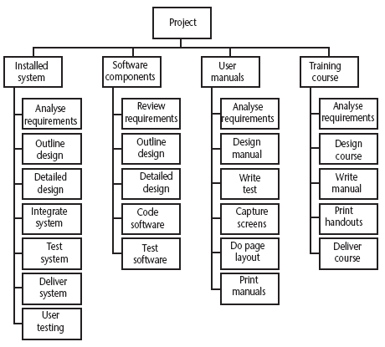
Hybrid approach
A Work Breakdown Structure based on deliverables
Notes:
The IBM MITP approach suggested the following 5 levels
Level 1: Project
Level 2: Deliverables
Level 3: Components – which are key work items needed to produce the deliverables
Level 4: Work packages: groups of tasks needed to produce the components
Level 5: Tasks

Slide 137
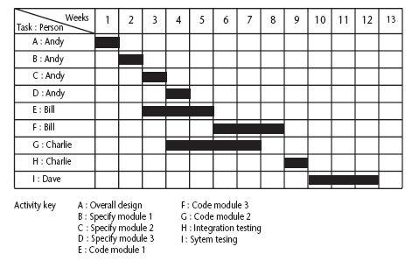
The final outcome of the planning process
A project plan as a bar chart
Notes:
The chart tells us who is doing what and when.

Slide 138
PERT vs CPM
Do B
PERT
Do A
Do D
Do C
CPM
Do B
Do A
Do D
Do C
Notes:
PERT was devised to support the development of the Polaris missile in the late 1950’s. CPM was developed by Du Pont Chemical Company who published the method in 1958.
PERT is an activity-on-node notation – the ‘nodes’ are the boxes which represent activities
CPM uses an activity-on-arrow notation where the arrows are the activities.
The approached described here is based on PERT but the other approach is described in the textbook as well – see Section 6.16

Slide 139
Drawing up a PERT diagram
No looping back is allowed – deal with iterations by hiding them within single activities
milestones – ‘activities’, such as the start and end of the project, which indicate transition points. They have zero duration.

Slide 140
Lagged activities
Where there is a fixed delay between activities e.g. seven days notice has to be given to users that a new release has been signed off and is to be installed
Acceptance
testing
7days
Install new
release
20 days
1day

Slide 141
Types of links between activities
Finish to start
Start to start/ Finish to finish
Software
development
Acceptance testing
Test prototype
2 days
Document
Amendments
1 day
Notes:
Finish to start: The following activity starts when the previous one has been finished
e.g. testing starts when coding has been completed
Start to start: When one activity starts another has to start as well
e.g. when prototype testing starts amendment documentation has to start as well
Finish to finish: when one activity finishes the other must finish too
e.g. when the testing of the prototype is completed so is the documentation of any amendments
You could use these with lags e.g. documentation of the changes to the prototype starts 1 day after the testing and finishes 2 days after testing has been completed

Slide 142
Types of links between activities
Start to finish
Operate temporary
system
Cutover to new
system
Acceptance test
of new system
Notes:
Start to finish – in the example when the cutover to the new system takes place, the operation of the temporary system is no longer needed. Although the cutover depends of the acceptance testing to be completed, the implication is that the cutover might not start straight after acceptance testing.

Slide 143
Start and finish times
Latest
finish
Earliest start
activity
Latest start
Earliest finish
Activity ‘write report software’
Earliest start (ES)
Earliest finish (EF) = ES + duration
Latest finish (LF) = latest task can be completed without affecting project end Latest start = LF - duration
Notes:
The time that an activity can start depends on its relationship with the other tasks in the project. The earliest start is when the earliest of the preceding activities upon which the current activity depends will be completed, so that the current one can start. If it starts at this time the earliest the current activity can finish is the earliest start plus its duration.
However, it may be that the activity, although it can start, can be delayed because later activities do not have to start right way. This gives us a latest finish date. The latest start date is the latest finish date less the duration of the activity.
When a student is given coursework to do they do not necessarily start it straight away. They might note when it has got to be handed in, work out that it will only take about three days to do - with a bit of luck - and wait until three days before the hand-in before they start.

Slide 144
Example
earliest start = day 5
latest finish = day 30
duration = 10 days
earliest finish = ?
latest start = ?
Float = LF - ES - duration
What is it in this case?
Notes:
The earliest finish (EF) would be day 5 plus 10 days i.e. day 15.
The latest start (LS) would be day 30 – 10 days i.e. day 20
The float would be 30 – 5 – 10 = 15 days
This also is the same as LF – EF or LS - ES

Slide 145
Notation
Activity description
Activity label
Duration
ES
EF
LS
LF
Activity span
Float
Notes:
The activity span is the LF -ES

Slide 146
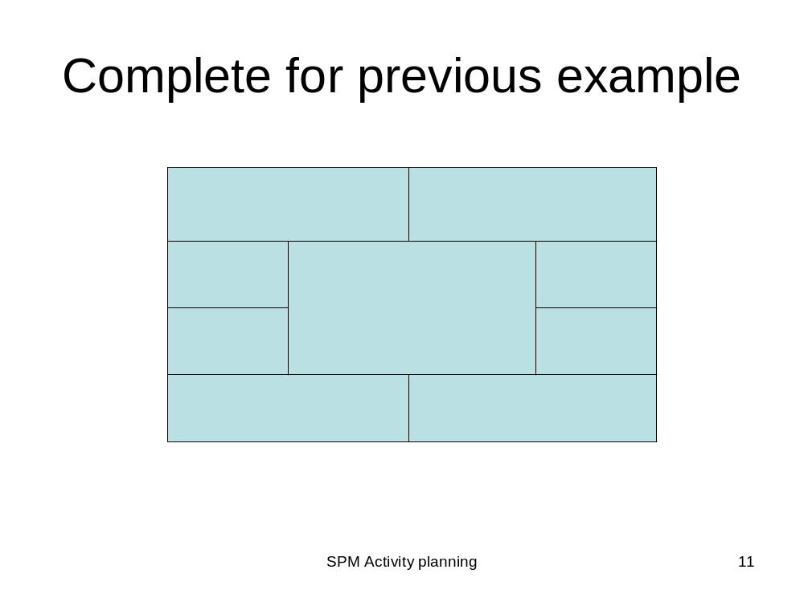
Notes:
Get students to complete the cells with the numbers from the previous example

Slide 147
Earliest start date
Earliest start date for the current activity = earliest finish date for the previous
When there is more than one previous activity, take the latest earliest finish
Note ‘day 7’ = end of work on day 7
EF = day 7
ES = day10
EF = day10

Slide 148
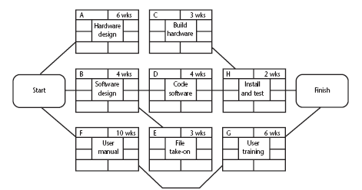
Example of an activity network
Notes:
Work out the earliest start and end dates for each activity

Slide 149
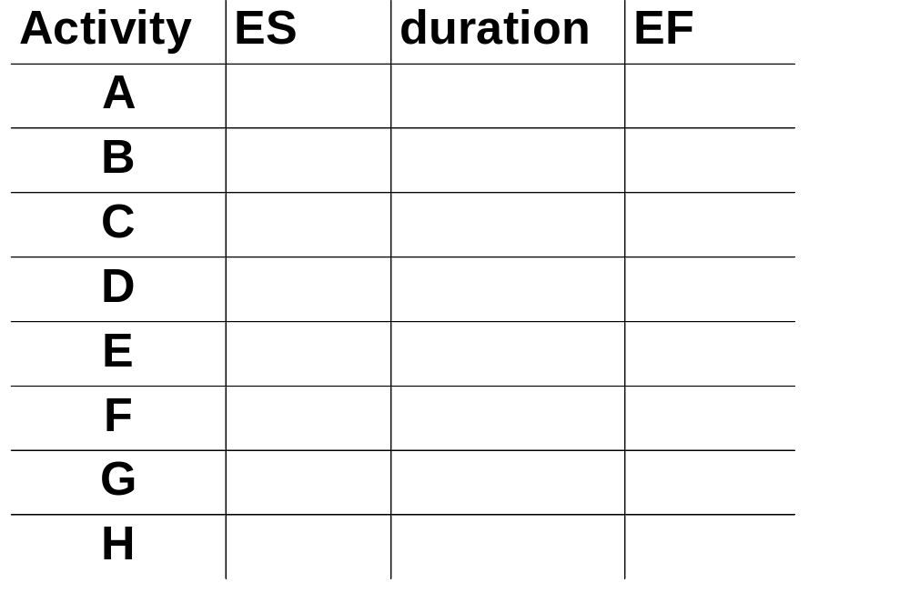
Complete the table
Notes:
Activity ES duration EF
A 0 6 6
B 0 4 4
C 6 3 9
D 4 4 8
E 4 3 7
F 0 10 10
G 10 3 14
H 9 2 11

Slide 150
Latest start dates
Start from the last activity
Latest finish (LF) for last activity = earliest finish (EF)
work backwards
Latest finish for current activity = Latest start for the following
More than one following activity - take the earliest LS
Latest start (LS) = LF for activity - duration

Slide 151
Example: LS for all activities?
Notes:
Get students to work out the latest starts and finishes for all the activities in the example

Slide 152
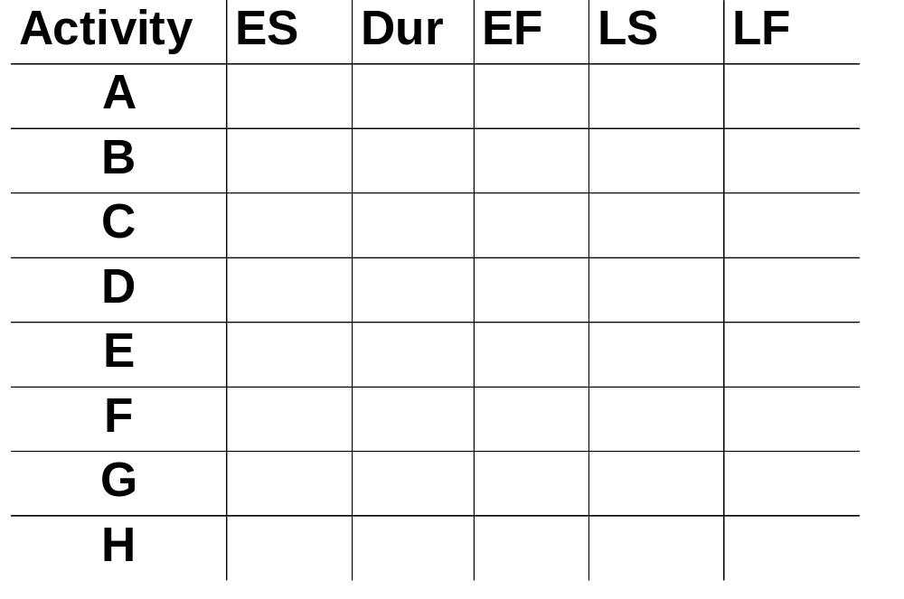
Complete the table
Notes:
Activity ES duration EF LS LF
A 0 6 6 2 8
B 0 4 4 3 7
C 6 3 9 8 11
D 4 4 8 7 11
E 4 3 7 7 10
F 0 10 10 0 10
G 10 3 14 10 13
H 9 2 11 11 13

Slide 153

Float
Float = Latest finish -
Earliest start -
Duration
FLOAT
LF
ES
activity
Latest start
Notes:
Note that Float can also be calculated as the difference between the earliest and latest start dates for an activity or the difference between the earliest and latest finish dates.

Slide 154
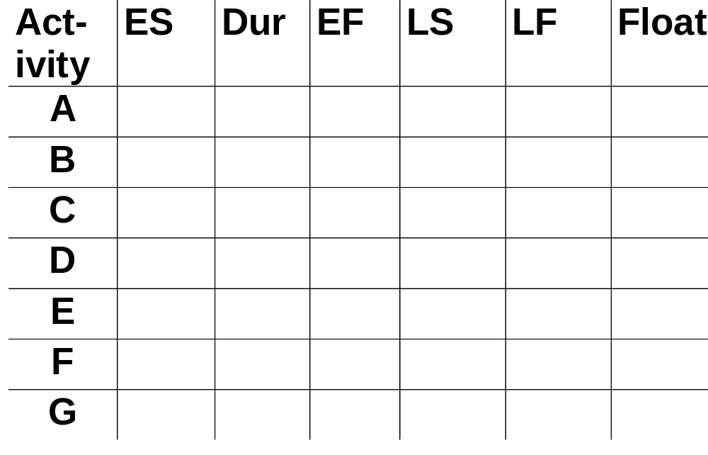
Complete the table
Notes:
A 2
B 3
C 2
D 3
E 3
F 0
G 0
H 2

Slide 155
Critical path
Note the path through network with zero floats
Critical path: any delay in an activity on this path will delay whole project
Can there be more than one critical path?
Can there be no critical path?
Sub-critical paths
Notes:
Yes, there could be more than one critical path if the two longest paths through the network were of equal length.
Where the target completion date for the project was imposed rather than calculated from the earliest finish dates, it might be later that the earliest finish date. In this case there would be no chains of activities with zero floats
The durations of activities are only estimates to start with. As the project proceeds, the estimates will be replaced by actual durations which could be different. This could change the sequence of activities identified as the critical path. Sub-critical paths are chains of activities, not on the planned critical path, but which have small floats and which could easily become the critical path as the project develops.

Slide 156
Free and interfering float
A
7w
0
B can be up to 3 days late
and not affect any
other activity = free float
7
2
9
2
B
4w
D
1w
E
2w
0
4
7
8
10
12
5
9
9
10
10
12
5
2
0
C
10w
0
10
0
10
B can be a further 2 days late – affects
D but not the project end date =
interfering float
0
Notes:
Total float = LF – ES – duration (or LS-ES or LF-EF)
Free float = ES for following activity less EF for the current
Interfering float = total float – free float

Slide 157
Software Project Management
4th Edition
Chapter 7
Risk management
Notes:
This talk provides an overview of the basic steps needed to produce a project plan. The framework provided should allow students to identify where some of the particular issues discussed in other chapters are applied to the planning process. As the focus is on project planning, techniques to do with project control are not explicitly described. However, in practice, one element of project planning will be to decide what project control procedures need to be in place.

Slide 158
Risk management
This lecture will touch upon:
Definition of ‘risk’ and ‘risk management’
Some ways of categorizing risk
Risk management
  Risk identification – what are the risks to a project?
  Risk analysis – which ones are really serious?
  Risk planning – what shall we do?
  Risk monitoring – has the planning worked?
We will also look at PERT risk and critical chains

Slide 159
Some definitions of risk
‘the chance of exposure to the adverse consequences of future events’ PRINCE2
Project plans have to be based on assumptions
Risk is the possibility that an assumption is wrong
When the risk happens it becomes a problem or an issue

Slide 160
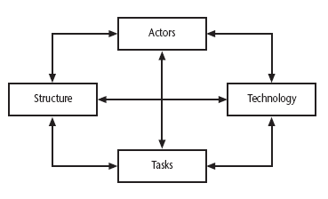
Categories of risk
Notes:
This is based on Lyytinen’s sociotechnical model of risk
Actors relate to all those involved in the project including both developers, users and managers e.g. a risk could be that high staff turnover leads to information of importance to the project being lost
Technology – both that used to implement the project and that embedded in the project deliverables – risk could be that the technologies selected are not in fact appropriate.
Structure – this includes management procedures, risk here is that a group who need to carry out a particular project task are not informed of this need because they are not part of the project communication network
Tasks – the work to be carried out. A typical risk is that the amount of effort needed to carry out the task is underestimated.
A risk could be well belong to more than one of the four areas – for example, estimates being wrong could be influenced by problems with actors (e.g. lack of experience with a technical domain) or the structure (over optimism of managers keen to win work).
Exercise 7.2 in the text will be some practice in identifying and categorizing risks

Slide 161
ISPL situational factors: the target domain
class
information system
computer system
description
the characteristics of the information system - these are independent of the technologies that might be used
the characteristics of the part of the information system that have been computerized
Notes:
ISPL used formerly to be known as Euromethod which was designed to assist in the selection of the best approach to project implementation. It identified situational factors features either of the application to be developed (the target domain) or the project environment (see next overhead). These two domains then had a number of classes of situational factors that might be relevant.

Slide 162
ISPL situational factors: project domain
Project
Structure
Actors
Technology
the types of task to be undertaken
the communication systems, management structures, work flows etc
the people involved in the project
the methods, techniques and tools to be used

Slide 163
A framework for dealing with risk
The planning for risk includes these steps:
Risk identification – what risks might there be?
Risk analysis and prioritization – which are the most serious risks?
Risk planning – what are we going to do about them?
Risk monitoring – what is the current state of the risk?

Slide 164
Risk identification
Approaches to identifying risks include:
Use of checklists – usually based on the experience of past projects
Brainstorming – getting knowledgeable stakeholders together to pool concerns
Causal mapping – identifying possible chains of cause and effect

Slide 165
Boehm’s top 10 development risks
Risk | Risk reduction techniques
Personnel shortfalls | Staffing with top talent; job matching; teambuilding; training and career development; early scheduling of key personnel
Unrealistic time and cost estimates | Multiple estimation techniques; design to cost; incremental development; recording and analysis of past projects; standardization of methods
Developing the wrong software functions | Improved software evaluation; formal specification methods; user surveys; prototyping; early user manuals
Developing the wrong user interface | Prototyping; task analysis; user involvement
Notes:
Barry Boehm surveyed software engineering project leaders to find out the main risks that they had experienced with their projects. For each risk, some risk reduction techniques has been suggested.

Slide 166
Boehm’s top ten risk - continued
Gold plating | Requirements scrubbing, prototyping, design to cost
Late changes to requirements | Change control, incremental development
Shortfalls in externally supplied components | Benchmarking, inspections, formal specifications, contractual agreements, quality controls
Shortfalls in externally performed tasks | Quality assurance procedures, competitive design etc
Real time performance problems | Simulation, prototyping, tuning
Development technically too difficult | Technical analysis, cost-benefit analysis, prototyping , training
Notes:
‘Gold plating‘ refers to inclusion of features that in fact are unnecessary and which end up never actually being used.

Slide 167
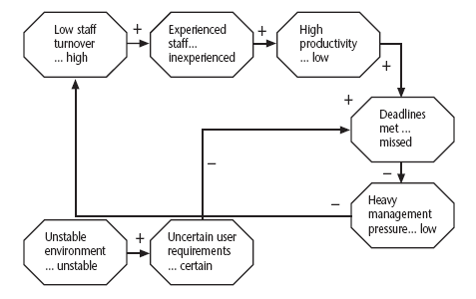
Causal mapping
Notes:
The idea here is to get the major stakeholders together and to brainstorm collectively the things that could go wrong. The causes of the problems identified are traced back using the mapping technique which identifies the project factors ( or ‘concept variables’) that people see as being important and the causal links between them. These links can be positive or negative.
Where possible, for each factor, positive and negative aspects are identified e.g. ‘stable…unstable requirements’.

Slide 168
Causal mapping - interventions
Notes:
Once a causal map has been drawn up identifying possible negative outcomes and their causes, the map can be modified to introduce policies or interventions which should reduce or mitigate the effects of the negative outcomes.
Often a risk reduction activity can actually introduce new risks. The use of consultants to offset the effects of skill shortages is an example of this. Causal mapping can help identify such adverse side-effects.

Slide 169
Risk prioritization
Risk exposure (RE)
= (potential damage) x (probability of occurrence)
Ideally
Potential damage: a money value e.g. a flood would cause £0.5 millions of damage
Probability 0.00 (absolutely no chance) to 1.00 (absolutely certain) e.g. 0.01 (one in hundred chance)
RE = £0.5m x 0.01 = £5,000
Crudely analogous to the amount needed for an insurance premium
Notes:
If there were 100 people chipping in £5,000 each, there would be enough for the 1 in 100 chance of the flooding. If there were 2 floods then the system collapses!
Exercise 7.4 in the textbook is strongly recommended to explore these issues.
In practice, with project risks, these quantitative approaches are usually impractical and more qualitative approaches are used instead. See the next overhead.

Slide 170
Risk probability: qualitative descriptors
Probability level | Range
High | Greater than 50% chance of happening
Significant | 30-50% chance of happening
Moderate | 10-29% chance of happening
Low | Less than 10% chance of happening
Notes:
Managers would be happier identifying an approximate range rather than a precise probability.

Slide 171
Qualitative descriptors of impact on cost and associated range values
Impact level | Range
High | Greater than 30% above budgeted expenditure
Significant | 20 to 29% above budgeted expenditure
Moderate | 10 to 19% above budgeted expenditure
Low | Within 10% of budgeted expenditure.
Notes:
Similar tables can be produced for the impact on project duration and on the quality of project deliverables.
The problem with the qualitative approach is how do you combine the judgements about probability and impact – you can’t multiply them together.

Slide 172
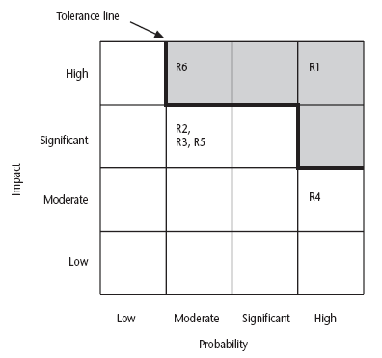
Probability impact matrix
Notes:
R1, R2 etc refer to particular risks (See Table 7.4 in the textbook). They are located on the grid according to the likelihood and impact ratings that have been allocated to them. A zone around the top right hand corner of the grid can be designated and risks falling within that zone are treated as requiring urgent action.

Slide 173
Risk planning
Risks can be dealt with by:
Risk acceptance
Risk avoidance
Risk reduction
Risk transfer
Risk mitigation/contingency measures
Notes:
Risk acceptance – the cost of avoiding the risk may be greater than the actual cost of the damage that might be inflicted
Risk avoidance – avoid the environment in which the risk occurs e.g. buying an OTS application would avoid a lot of the risks associated with software development e.g. poor estimates of effort.
Risk reduction – the risk is accepted but actions are taken to reduce its likelihood e.g. prototypes ought to reduce the risk of incorrect requirements
Risk transfer – the risk is transferred to another person or organization. The risk of incorrect development estimates can be transferred by negotiating a fixed price contract with an outside software supplier.
Risk mitigation – tries to reduce the impact if the risk does occur e.g. taking backups to allow rapid recovery in the case of data corruption

Slide 174
Risk reduction leverage
Risk reduction leverage =
(RE_{before}- RE_{after})/ (cost of risk reduction)
RE_{before}is risk exposure before risk reduction e.g. 1% chance of a fire causing £200k damage
RE_{after} is risk exposure after risk reduction e.g. fire alarm costing £500 reduces probability of fire damage to 0.5%
RRL = (1% of £200k)-(0.5% of £200k)/£500 = 2
RRL > 1.00 therefore worth doing
Notes:
If you think in terms of the analogy to insurance. An insurance company might reduce the fire insurance premium from £2k to £1k on condition that a fire alarm is installed. The insured would save £1k a year by investing £500 so it would be worth doing.

Slide 175
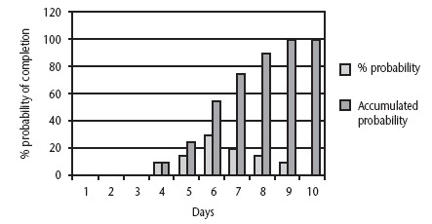
Probability chart
Notes:
As was pointed out in Chapter 5, an estimate of activity duration is realistically a range of values clustered around the most likely value are trailing off on either side of this central value.
How can we take account of this in project planning. An answer might be the PERT risk technique.

Slide 176
Using PERT to evaluate the effects of uncertainty
Three estimates are produced for each activity
Most likely time (m)
Optimistic time (a)
Pessimistic (b)
‘expected time’ t_{e} = (a + 4m +b) / 6
‘activity standard deviation’ S = (b-a)/6
Notes:
Most likely time (m) the time we would expect the task to take normally
Optimistic time (a) the shortest time could be realistically be expected
Pessimistic (b) worst possible time (only 1% chance of being worse, say)
Some straightforward activities (data input of standing data might perhaps be an example) might have little uncertainty and therefore have a low standard deviation, while others (software design, for instance?) have more uncertainty and would have a bigger standard deviation.
Exercise 7.6 in the textbook will give some practice in calculating these values.

Slide 177
A chain of activities
Task A
Task B
Task C
Task | a | m | b | t_{e} | s
A | 10 | 12 | 16 | ? | ?
B | 8 | 10 | 14 | ? | ?
C | 20 | 24 | 38 | ? | ?
Notes:
Fill the missing gaps?
T_{e}
Task A t_{e} = (10+ (12 x 4) + 16)/ 6 i.e. 12.66 s = (16-10)/6 i.e. 1
Task B t_{e} = (8 + (10 x 4) + 14)/ 6 i.e. 10.33 s = (14-8)/6 i.e. 1
Task C T_{e} = (20 + (24 x 4) + 38)/6 i.e. 25.66 s = (38-20)/6 i.e. 3

Slide 178
A chain of activities
What would be the expected duration of the chain A + B + C?
Answer: 12.66 + 10.33 + 25.66 i.e. 48.65
What would be the standard deviation for A + B+ C?
Answer: square root of (1² + 1² + 3²) i.e.
3.32
Notes:
Get them to guess the square root if no one has a laptop with excel or a scientific calculator!

Slide 179
Assessing the likelihood of meeting a target
Say the target for completing A+B+C was 52 days (T)
Calculate the z value thus
z = (T – t_{e})/s
In this example z = (52-48.33)/3.32 i.e. 1.01
Look up in table of z values – see next overhead

Slide 180
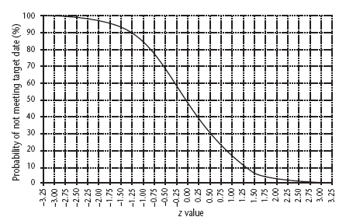
Graph of z values
Notes:
There is about a 15% chance of not meeting the target of 52 days.

Slide 181
Critical chain approach
One problem with estimates of task duration:
Estimators add a safety zone to estimate to take account of possible difficulties
Developers work to the estimate + safety zone, so time is lost
No advantage is taken of opportunities where tasks can finish early – and provide a buffer for later activities
Notes:
Developers will tend to start activities as late as is compatible with meeting the target date as they often have other urgent work to be getting on with in the mean time.

Slide 182
Critical chain approach
One answer to this:
Base targets on midpoints (i.e. t_{e})
Accumulate 50% of the safety zones (between t_{e} and b) into a buffer at the end of the project
Work backwards and start all activities at their latest start dates
During project execution use relay race model
Notes:
This approach means that the ‘safety buffer’ in the estimate for an activity is moved from the individual developer to the project as a whole.
The ‘relay race’ principle is that the project manager makes sure that team members are ready to immediately start dependent activities as soon as the preceding activity is finished.

Slide 183
Software Project Management
4th Edition
Chapter 8
Resource allocation
Notes:
This talk provides an overview of the basic steps needed to produce a project plan. The framework provided should allow students to identify where some of the particular issues discussed in other chapters are applied to the planning process. As the focus is on project planning, techniques to do with project control are not explicitly described. However, in practice, one element of project planning will be to decide what project control procedures need to be in place.

Slide 184
Schedules
Activity schedule - indicating start and completion dates for each activity
Resource schedule - indicating dates when resources needed + level of resources
Cost schedule showing accumulative expenditure
Notes:
We have already described the creation of the activity schedule in Lecture/activity 6.

Slide 185
Resources
These include
  labour
  equipment (e.g. workstations)
  materials
  space
  services
Time: elapsed time can often be reduced by adding more staff
Money: used to buy the other resources
Notes:
Section 8.2 in the main text discusses this in a little more detail.
A key point is that money (by definition) is the means by which one resource can be converted to another. However in practice this may be problematic because of resource constraints e.g. staff need time to become expert in a new technology regardless of the amount of money that might be available to buy expertise.

Slide 186
Resource allocation
Identify the resources needed for each activity
Identify resource types - individuals are interchangeable within the group (e.g. ‘VB programmers’ as opposed to ‘software developers’)
Allocate resource types to activities and examine the resource histogram
Notes:
This is covered in Section 8.3 of the text.
Note that at this point we have to assume that we are dealing with, for example, ‘standard’ software developers who have an average productivity. When we allocate actual people we may find that we have a trainee or a super-expert and this will affect productivity. A short-coming in productivity in an individual might be compensated for by a lower cost (as would be expected with trainees).
In the example in the text we start by scheduling every activity to start at the earliest possible date. However in Lecture/Chapter 7, in the section on the critical chain technique it was suggested that we plan to start activities as late as possible. Whatever the starting procedure, we then need to deal with resource clashes.

Slide 187
Resource histogram: systems analysts
5
4
STAFF REQD.
3
2
1
1
2
3
4
5
6
7
WEEK
Notes:
The resource histogram helps us identify where the demand for a resource exceeds the supply.
If we use a tool such as MS Project, the tool will generate the resource histograms for us.

Slide 188
Resource clashes
can be resolved by:
  delaying one of the activities
    taking advantage of float to change start date
    delaying start of one activity until finish of the other activity that resource is being used on - puts back project completion
  moving resource from a non-critical activity
  bringing in additional resource - increases costs
Notes:
Exercise 8.1 in the text gives some practice in the resolution of resource clashes.

Slide 189
Prioritizing activities
There are two main ways of doing this:
Total float priority – those with the smallest float have the highest priority
Ordered list priority – this takes account of the duration of the activity as well as the float – see next overhead
Notes:
Where more than one activity is competing for the same limited resource at the same time then those activities need to be prioritized.

Slide 190
Burman’s priority list
Give priority to:
Shortest critical activities
Other critical activities
Shortest non-critical activities
Non-critical activities with least float
Non-critical activities

Slide 191
Resource usage
Need to maximise %usage of resources i.e. reduce idle periods between tasks
Need to balance costs against early completion date
Need to allow for contingency

Slide 192
Critical path
Scheduling resources can create new dependencies between activities – recall critical chains
It is best not to add dependencies to the activity network to reflect resource constraints
  Makes network very messy
  A resource constraint may disappear during the project, but link remains on network
Amend dates on schedule to reflect resource constraints
Notes:
In Lecture/chapter 7 the concept of critical chains was introduced which took account of resource constraints.
The point about not adding links to the network to deal with resource constraints is not in the text, but is based on practical experience. The notation for activity networks does not tell you why one activity might be dependent on the completion of another.

Slide 193
Allocating individuals to activities
The initial ‘resource types’ for a task have to be replaced by actual individuals.
Factors to be considered:
Availability
Criticality
Risk
Training
Team building – and motivation
Notes:
Availability – who is free? Note that this will change during the course of the project as some tasks are completed earlier or later than planned
Criticality – You would want to put your more experienced, ‘safer’, staff on the critical activities
Risk – this is similar to the point above, but some activities could be off the critical path but still have risks e.g. to the quality of subsequent products
Training – despite concerns about minimizing risk, it is healthy to take some risks in order to develop staff capabilities by allocating challenging tasks to relatively inexperienced stafff
Team-building – identifying people who work well together can pay dividends; chopping and changing plans all the time may in theory optimize project performance, but can in practice be demotivating for staff

Slide 194
Cost schedules
Cost schedules can now be produced:
Costs include:
Staff costs
Overheads
Usage charges
Notes:
Section 8.9 covers this in more depth.
Staff costs – includes not just salary, but also social security contributions by the employer, holiday pay etc. Timesheets are often used to record actual hours spent on each project by an individual. One issue can be how time when a staff member is allocated and available to the project, but is not actually working on the project, is dealt with.
Overheads e.g. space rental, service charges etc. Some overheads might be directly attributable to the project; in other cases a percentage of departmental overheads may be allocated to project costs.
Usage charges – some charges can be on a ‘pay as you go’ basis e.g. telephone charges, postage, car mileage – at the planning stage an estimate of these may have to be made

Slide 195
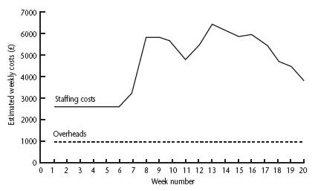
Cost profile
Notes:
This shows how much is going to be spent in each week. This could be important where an organization allocates project budgets by financial year or quarter and the project straddles more than one of these financial periods

Slide 196
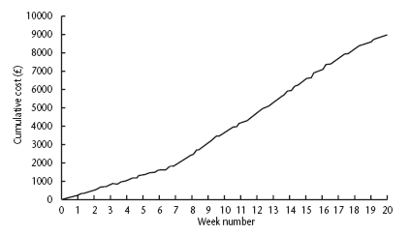
Accumulative costs
Notes:
The project manager will also be concerned about planned accumulative costs. This chart can be compared to the actual accumulative costs when controlling the project to assess whether the project is likely to meet its cost targets.

Slide 197
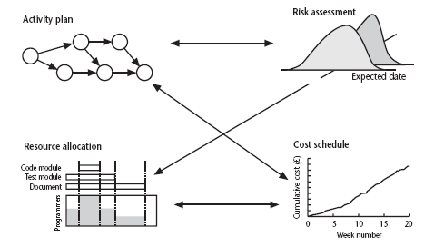
Balancing concerns
Notes:
Successful project scheduling is not a simple sequence.
Because of the inter-linking of different concerns project planning will need to be iterative. The consequences of decisions will need to carefully assessed and plans adjusted accordingly.

Slide 198
Software Project Management
4th Edition
Chapter 9
Monitoring and
control
Notes:
SPM monitoring and control
This talk provides an overview of the basic steps needed to produce a project plan. The framework provided should allow students to identify where some of the particular issues discussed in other chapters are applied to the planning process. As the focus is on project planning, techniques to do with project control are not explicitly described. However, in practice, one element of project planning will be to decide what project control procedures need to be in place.

Slide 199
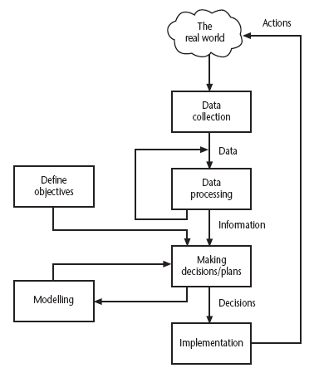
The control cycle
Notes:
SPM monitoring and control
Define objectives – at the beginning of the project we decide on what we want to achieve
Making decisions/plans – we decide how we are going to achieve the objectives i.e. we create a plan
Modelling – as part of the process of creating a plan we will consider different approaches and attempt to assess the consequences of each of these approaches in terms of how much it will cost and how long it will take, and so on.
Implementation – the plan is now carried out
Data collection – we gather information at regular intervals about how the project is progressing. These raw details could be quite numerous and complex on a large project
Data processing – we process the progress data and convert it into ‘information’ which makes it easier for the project managers and others to understand the overall condition of the project
Making decisions/plans – in the light of the comparison of actual project progress with that planned, the plans are modified. This may require the modelling of the outcomes of different possible courses of action
…and so the cycle goes on.

Slide 200
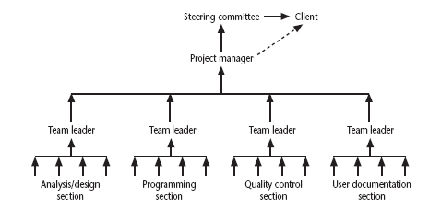
Responsibilities
Notes:
SPM monitoring and control
The concept of a reporting hierarchy was introduced in Chapter 1.
The main lesson here is that the details relating to project progress have to originate with the people actually doing the work and have then to be fed up through the management structure. At each management level there is going to be some summarising and commentary before information is passed up to the next level. This means that there is always a danger of ‘information overload’ as information passes from the many to the few.

Slide 201

Assessing progress
Checkpoints – predetermined times when progress is checked
  Event driven: check takes place when a particular event has been achieved
  Time driven: date of the check is pre-determined
Frequency of reporting
  The higher the management level then generally the longer the gaps between checkpoints
Notes:
SPM monitoring and control

Slide 202
Collecting progress details
Need to collect data about:
Achievements
Costs
A big problem: how to deal with partial completions
99% completion syndrome
Possible solutions:
Control of products, not activities
Subdivide into lots of sub-activities
Notes:
SPM monitoring and control
Projects have to be delivered on time and within budget, hence the concern with monitoring achievements and costs.
Partial completion is where, for example, data is being collected at the end of Week 2 of an activity that should take four weeks. We want to know if it is about 50% completed.
An example of the ’99% completion syndrome’ would be in the above case if the developer reported at the end of weeks 1,2 and 3 that the task was respectively 25%, 50% and 75% complete. However at the end of week 4 it is reported that the task is 99% complete. The same thing is reported at the end of week 5 and so on until the task is actually completed.
Control on products implies that actual examination of intermediate allows us to verify independently and objectively that sub-tasks have been completed.

Slide 203
Red/Amber/Green reporting
Identify key tasks
Break down into sub-tasks
Assess subtasks as:
  Green – ‘on target’
  Amber – ‘not on target but recoverable’
  Red – ‘not on target and recoverable only with difficulty’
Status of ‘critical’ tasks is particularly important
Notes:
SPM monitoring and control
RAG reporting highlights those activities which need particular attention. The status of a troubled activity might typically move from green to amber; if corrective action is possible it might go back to green, otherwise it could switch to red. If there are lots of instances where activities switch directly from green to red, this could indicate more management control.
‘Critical tasks’ would be those on the critical path and/or reliant on critical resources.

Slide 204
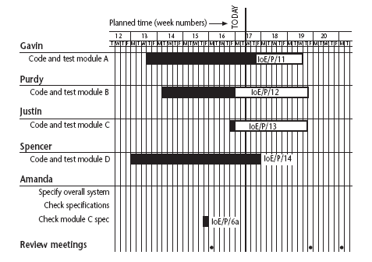
Gantt charts
Notes:
SPM monitoring and control
Note that the Gantt chart is named after Henry Gantt (1861-1919) and so should not be written in capitals! You could ask students what they think GANTT stands for before you tell them this to impress this on them. I really find Gantt written as GANTT very, very annoying and threaten students with instant failure of the module if they do this!
The format of the Gantt chart here differs from the format used in Microsoft project as the activities for each team member are grouped together. You could input the details so that they came out in this format, but it would not occur automatically.

Slide 205
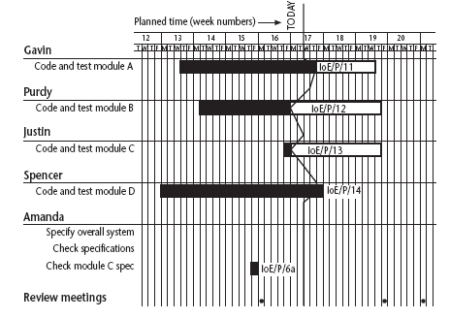
Slip charts
Notes:
SPM monitoring and control
A slip chart is a version of the Gantt chart where a line is drawn from top to bottom. To the left of the line are all the completed activities and to the right those activities ( or parts of activities) that have not been completed.
The more jagged the line, the more it means that that there are some activities that are lagging to various degrees and some that are ahead of themselves. A very jagged line means that there is scope for re-planning to move resources from those activities that are ahead to those that are behind.

Slide 206
Ball charts
Code and test module A
10/10/05
21/10/05
23/10/05
10/10/05
Code and test module B
14/10/05
17/10/05
27/10/05
31/10/05
Code and test module C
17/10/05
17/10/05
27/10/05
7/11/05
Notes:
SPM monitoring and control
Circles, which represent the start or finish of activities, start with the initial target dates. If these are modified then the second dates are changed. When the event actually takes place, the colour of the circle is changed to green if it is on target and to red if it has missed the target.
The idea is that this chart is put on a wall in a prominent position as a constant reminder to the project team of the current situation – hence it is often referred to as ‘balls on the wall’.

Slide 207
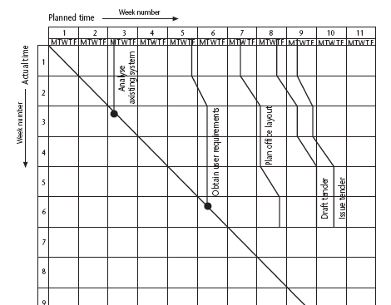
The timeline
Notes:
SPM monitoring and control
This records the way that targets have changed throughout the project.
Planned time is plotted on the horizontal axis, and actual time on the vertical axis. The bendy lines going from top to bottom represent the scheduled completion date for each activity e.g.
‘analyse existing system’ – at start this was due finish on the Monday of week 3 and it did finish then
‘obtain user requirements’ was originally planned to finish on the Thursday of week 5, but at the end of the first week it was rescheduled to finish on the Tuesday of week 6.

Slide 208
Cost monitoring
A project could be late because the staff originally committed, have not been deployed
In this case the project will be behind time but under budget
A project could be on time but only because additional resources have been added and so by over budget
Need to monitor both achievements and costs
Notes:
SPM monitoring and control

Slide 209
Earned value analysis
Planned value (PV) or Budgeted cost of work scheduled (BCWS) – original estimate of the effort/cost to complete a task (compare with idea of a ‘price’)
Earned value (EV) or Budgeted cost of work performed (BCWP) – total of PVs for the work completed at this time
Notes:
SPM monitoring and control

Slide 210
Accounting conventions
Conventions
  0/100 nothing allocated on start of activity, 100% on finish – used here
  50/50 half allocated at start, the other half on completion
  Milestone current value depends on the milestones achieved
Can use money values, or staff effort as a surrogate
Notes:
SPM monitoring and control

Slide 211
Earned value – an example
Tasks
  Specify module 5 days
  Code module 8 days
  Test module 6 days
At the beginning of day 20, PV = 19 days
If everything but testing completed EV = 13 days
Schedule variance = EV-PV i.e. 13-19 = -3
Schedule performance indicator (SPI) = 13/19 = 0.68
Notes:
SPM monitoring and control
A negative schedule variance (SV) means that the project is behind schedule as does a SPI that is less than 1.0.

Slide 212
Earned value analysis – actual cost
Actual cost (AC) is also known as Actual cost of work performed (ACWP)
In previous example, if
  ‘Specify module’ actually took 3 days
  ‘Code module’ actually took 4 days
Actual cost = 7 days
Cost variance (CV) = EV-AC i.e. 13-7 = 6 days
Cost performance indicator = 13/7 = 1.86
Positive CV or CPI < 1.00 means project under budget
Notes:
SPM monitoring and control

Slide 213
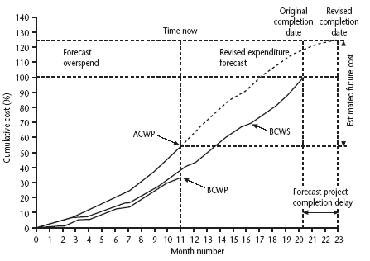
Earned value chart with revised forecasts
Notes:
SPM monitoring and control
This shows how the planned value (PV), earned value (EV) and actual cost (AC) can be tracked over the lifetime of a project.
It also shows how the graph can be used to show adjustments to the final estimated cost and duration. A revised assessment of the budget at completion (EAC estimate at completion) can be produced by dividing the original estimated budget at completion (BAC) by the current CPI.
Similarly a forecast of the actual duration of the project can be derived by dividing the original estimated duration by the SPI.

Slide 214
Prioritizing monitoring
We might focus more on monitoring certain types of activity e.g.
Critical path activities
Activities with no free float – if delayed later dependent activities are delayed
Activities with less than a specified float
High risk activities
Activities using critical resources
Notes:
SPM monitoring and control
Critical path activities – by definition if these are late then the project as a whole will be delayed
Activities with no free float – free float was defined in Lecture/Chapter 6. A project with no free float will delay following dependent activities, although the project end date may not be directly threatened.
Activities with less than a specified float – projects when being executed can be very dynamic: some activities will take longer than estimated others less; this could lead to the critical shifting. Activities with small floats are the most likely to find themselves turned into activities on the critical path if their floats get eroded.
High risk activities – recall the calculation of activity standard deviations in Chapter 7. If the standard deviation for an activity is large, this indicates that there is a lot of uncertainty about how long it will actually take.
Activities using critical resources – some resources may only be available for a limited period and if the activities that need the resource are delayed the resource could become unavailable.

Slide 215
Getting back on track: options
Renegotiate the deadline – if not possible then
Try to shorten critical path e.g.
  Work overtime
  Re-allocate staff from less pressing work
  Buy in more staff
Reconsider activity dependencies
  Over-lap the activities so that the start of one activity does not have to wait for completion of another
  Split activities
Notes:
SPM monitoring and control
Renegotiating the deadline – one way of doing this is to divide the deliverables into ‘tranches’ (see Lecture/Chapter 3), delivering the ones most valuable to the client on or before the deadline, but delaying less valuable ones.
Shortening the critical path – the idea is to try to get things done more quickly by adding more staff. Some activities lend themselves to this more readily than others – it is often quite difficult to do this with software development. It also increases costs
Reconsidering activity dependencies – allowing activities to overlap often increases the risk of quality shortfalls

Slide 216
Change control
The role of configuration librarian:
Identifying items that need to be subject to change control
Management of a central repository of the master copies of software and documentation
Administering change procedures
Maintenance of access records
Notes:
SPM monitoring and control
Identifying items that need to be subject to change control – it is unlikely, for example, that a feasibility report would be subject to change control once agreement has been obtained to start the project
Management of a central repository of the master copies of software and documentation
Administering change procedures It is important that someone ensures that there is adherence to change control procedures.
Maintenance of access records. A situation to be avoided is where two different developers are making changes to the same software component.

Slide 217
Typical change control process
One or more users might perceive the need for a change
User management decide that the change is valid and worthwhile and pass it to development management
A developer is assigned to assess the practicality and cost of making the change
Development management report back to user management on the cost of the change; user management decide whether to go ahead
Notes:
SPM monitoring and control
1 and 2. The user community itself must come to a consensus about whether a proposal for a change should go forward. A change deemed desirable by one part of the user community could cause opposition with other users.
2 and 3. This part of the process often involves a multipart form, initially raised by a user representative and then completed with a response by the developers.
4. There could be a change control board with user and developer representatives that oversees this decision-making process

Slide 218
Change control process contd.
One or more developers are authorized to make copies of components to be modified
Copies modified. After initial testing, a test version might be released to users for acceptance testing
When users are satisfied then operational release authorized – master configuration items updated
Notes:
SPM monitoring and control
5. The configuration librarian would control this release
6. Note that it is a copy that is modified; the original would still exist as the current operational version
7. The previous version of the configuration items would be archived but preserved. If there are unforeseen problems with the new version when it is made operational then a fall-back to the previous version could be considered

Slide 219
Software Project Management
4th Edition
Chapter 10
Managing contracts
Notes:
This talk provides an overview of the basic steps needed to produce a project plan. The framework provided should allow students to identify where some of the particular issues discussed in other chapters are applied to the planning process. As the focus is on project planning, techniques to do with project control are not explicitly described. However, in practice, one element of project planning will be to decide what project control procedures need to be in place.

Slide 220
Acquiring software from external supplier
This could be:
a bespoke system - created specially for the customer
off-the-shelf - bought ‘as is’
customized off-the-shelf (COTS) - a core system is customized to meet needs of a particular customer

Slide 221
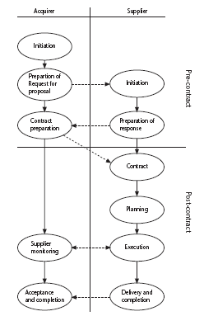
ISO 12207 acquisition and supply process
Notes:
Part of the ISO 12207 standard relates to the process by which software can be acquired from an external supplier. As can be seen from the diagram, there are two parallel and complementary processes. The acquirer (who wants the software) has a set of processes to carry out which interact with the processes for which the supplier would be responsible.
Sections 10.2 and 10.3 of the textbook cover this in more detail.

Slide 222
Types of contract
fixed price contracts
time and materials contracts
fixed price per delivered unit
Note difference between goods and services
Often license to use software is bought rather than the software itself
Notes:
Section 10.4 of the textbook provides more detail about the types of contract.

Slide 223
Fixed price contracts
Advantages to customer
known expenditure
supplier motivated to be cost-effective

Slide 224
Fixed price contracts
Disadvantages
supplier will increase price to meet contingencies
difficult to modify requirements
upward pressure on the cost of changes
threat to system quality
Notes:
Even though the supplier will have to add a margin to the price to deal with contingencies, the cost could still be less than doing the work in-house as the supplier may be able to exploit economies of scale and the expertise that the have from having done similar projects in the past.

Slide 225
Time and materials
Advantages to customer
easy to change requirements
lack of price pressure can assist product quality

Slide 226
Time and materials
Disadvantages
Customer liability - the customer absorbs all the risk associated with poorly defined or changing requirements
Lack of incentive for supplier to be cost-effective
Notes:
Because suppliers appear to be given a blank cheque, this approach does not normally find favour with customers. However, the employment of contract developers may involve this type of contract.

Slide 227
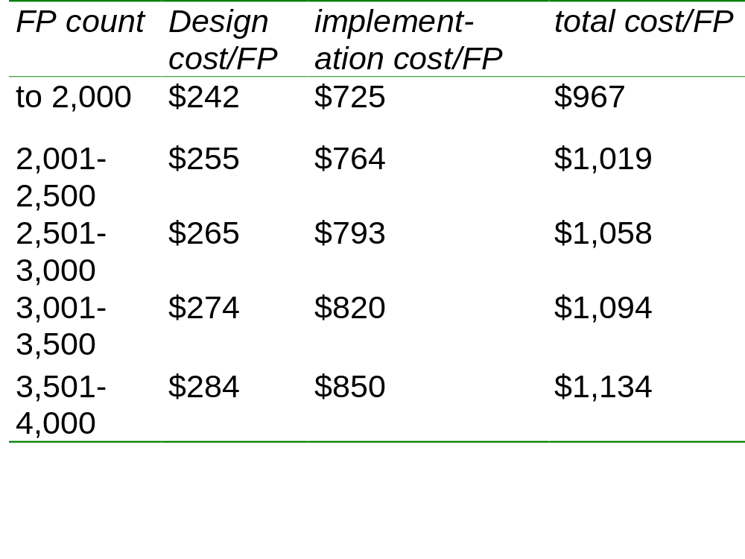
Fixed price per unit delivered
Notes:
These figures do come from a real source (RDI Technologies in the USA). These are now several year old. The bigger the project, the higher the cost per function point. Recall that function points were covered in Lecture/Chapter 5 on software effort estimation.

Slide 228
Fixed price/unit example
Estimated system size 2,600 FPs
Price
  2000 FPs x $967 plus
  500 FPs x $1,019 plus
  100 FPs x $1,058
  i.e. $2,549,300
What would be charge for 3,200 FPs?
Notes:
2000 FPs at $967 = $1,934,000
500 FPs at $1019 = $509,500
500 FPs at $1058 = $529,000
200 FPs at $1094 $218,800
total $3,191,300

Slide 229
Fixed price/unit
Advantages for customer
customer understanding of how price is calculated
comparability between different pricing schedules
emerging functionality can be accounted for
supplier incentive to be cost-effective

Slide 230
Fixed price/unit
Disadvantages
difficulties with software size measurement - may need independent FP counter
changing (as opposed to new) requirements: how do you charge?

Slide 231
The tendering process
Open tendering
  any supplier can bid in response to the invitation to tender
  all tenders must be evaluated in the same way
  government bodies may have to do this by local/international law

Slide 232
The tendering process
Restricted tendering process
  bids only from those specifically invited
  can reduce suppliers being considered at any stage
Negotiated procedure
  negotiate with one supplier e.g. for extensions to software already supplied

Slide 233
Stages in contract placement
requirements
analysis
evaluation
plan
invitation to
tender
evaluation of
proposals

Slide 234
Requirements document: sections
introduction
description of existing system and current environment
future strategy or plans
system requirements -
  mandatory/desirable features
deadlines
additional information required from bidders
Notes:
The requirements document is sometimes referred to as the operational requirement or OR.
If a mandatory requirement cannot be met the proposed application would have to be rejected regardless of how good it might be in other ways.
A shortfall in one desirable requirement might be compensated for by other qualities or features.

Slide 235
Requirements
These will include
  functions in software, with necessary inputs and outputs
  standards to be adhered to
  other applications with which software is to be compatible
  quality requirements e.g. response times

Slide 236
Evaluation plan
How are proposals to be evaluated?
Methods could include:
  reading proposals
  interviews
  demonstrations
  site visits
  practical tests
Notes:
Off the shelf software clearly has an advantage here as there is actually product that can be evaluated in existence.

Slide 237
Evaluation plan - contd.
Need to assess value for money for each desirable feature
Example:
  feeder file saves data input
  4 hours a month saved
  cost of inputter £20 an hour
  system to be used for 4 years
  if cost of feature £1000, would it be worth it?
Notes:
£(4 x 10 x 12 x 4) would be saved i.e. £3,840. The payback period would be just over a year and so this feature would be worth the additional cost.

Slide 238
Invitation to tender (ITT)
Note that bidder is making an offer in response to ITT
acceptance of offer creates a contract
Customer may need further information
Problem of different technical solutions to the same problem
Notes:
ISO 12207 refers to an ITT as a Request for Proposal or RFP.

Slide 239
Memoranda of agreement (MoA)
Customer asks for technical proposals
Technical proposals are examined and discussed
Agreed technical solution in MoA
Tenders are then requested from suppliers based in MoA
Tenders judged on price
Fee could be paid for technical proposals by customer

Slide 240
How would you evaluate the following?
usability of an existing package
usability of an application yet to be built
maintenance costs of hardware
time taken to respond to requests for software support
training
Notes:
Usability of existing package – you could try out a demo or ask existing users
Usability of application to be built – here you would have to make stipulation about the process e.g. on the development of interface prototypes; you could also specify performance requirements
Maintenance costs of hardware – this could be incorporated in a maintenance agreement and you could compare the terms offered by different potential suppliers; another approach is ask current users of the hardware about their experience of it
Time taken to respond to support requests – this could once again be made a contractual matter and the terms offered by different suppliers could be compared; suppliers could be asked to supply evidence of their past performance (but they might refuse, or not tell the truth); you could ask for references from current customers of the supplier;
Training – once again references could be taken up; you could ask for the CV of the trainer; you could even get them to give a short presentation

Slide 241
Contract management
Contracts should include agreement about how customer/supplier relationship is to be managed e.g.
  decision points - could be linked to payment
  quality reviews
  changes to requirements

